Slide 1

2016 Kick-Off Meeting
February 23, 2016

Slide 2
IEEE PES GMS Contact Information
Chair: Jeff Carrara JCarrara@velco.com
Vice-Chair: Josh Burroughs JBurroughs@velco.com
Treasurer: Diana Lee Dlee@velco.com
Webmaster: Lou Cecere LCecere@velco.com
Secretary: Lou Cecere LCecere@velco.com
Tech Mtg Coord: Bernadette Fernandes BFernandes@velco.com
Please contact us if you are interested in volunteering
http://sites.ieee.org/gms-pes/
Notes:
This Society was founded almost 125 years ago with the mission of serving the members of our profession.
Our mission is to be the leading provider of scientific and engineering information on electric power and energy for the betterment of society and the preferred professional development source for our members.
Our mission going forward will continue to be the same while our profession faces an environment of rapid and often breathtaking change.
Our task is to address the many challenges that lay before us. To do this, we need to take advantage of our heritage and strengths while aggressively pursuing opportunities that will enable us to continue another 125 years and beyond.

Slide 3
Summary of Last Year
Feb 19th
  “Understanding and managing the impacts of PEVs on the electric grid”
  “Drive Electric Vermont-Partnering for Plug-in Vehicle Adoption in the Green Mountain State”
Mar 16th “The Future of Energy: Smart Grid and Beyond”
May 14th Highgate HVDC Converter Tour
Sept 17th PES Technical Seminar & Stafford Hill Solar Tour
  “DG Interconnection Issues concerning IEEE 1547 and UL 1741”
  “Energy Storage Systems”
  “Renewable Generation Forecasting”
Dec 4th “Smart Grid Innovation in Vermont” and Awards Ceremony
Notes:
Thank you to Jacek for involvement last year

Slide 4
Topic-Interest Surveys
1st Survey Nov/Dec 2014
  Renewable Energy (2.86) *
  HVDC/FACTS technology (2.86)
  Energy Storage (2.85)
  Smart grid and microgrids (2.79)
  Geomagnetic induced currents (GIC) (2.79)*
  Write-in interest in voltage support/control, cyber security & managing Big Data
2nd Survey May 2015
  Energy Storage (2.78)
  Smart grid and microgrids (2.71)
  ISO-New England markets (2.63)
Last Survey October 2015
  Energy Storage (2.67)
  Smart grid and microgrids (2.59)
  HVDC/FACTS technology (2.41)
  New Topics for next survey?

Slide 5
Plans so far for 2016
Jan 27th - Norwich University, “Engineering: College to Career”
Feb 23rd - 2016 Kickoff Meeting
Mar - ISO Markets & Consumer Behavior Study (DOE/VEC)
April 21st – UVM IGERT (http://www.uvm.edu/smartgrid/)
May – Weidmann (http://www.weidmann-electrical.com/en/)
  Plant Tour (St. Johnsbury)
July 17th – 21st - IEEE PES General Meeting in Boston
  http://www.pes-gm.org/2016/
June, July or August - Kingdom Community Wind Tour
Tutorials? Note future PDH/CEUs
Distinguished Lecturer http://www.ieee.org/about/volunteers/tab/distinguished_lecturer_program.html
December - Annual IEEE GMS Section Awards Ceremony

Slide 6
IEEE Senior Membership
Presented by
IEEE Green Mountain Section PES Chapter
February 23, 2016

Slide 7
Eligibility
Ten Years of Professional Experience
  Partial credit for educational experience available
Five Years of Significant Performance
  Many prospective applicants make the mistake of assuming that "significant performance" requires special awards, patents, or other extremely sophisticated technical accomplishments, but this is not the case. Substantial job responsibilities such as team leader, task supervisor, engineer in charge of a program or project, engineer or scientist performing research with some measure of success (papers), or faculty developing and teaching courses with research and publications, all are indications of significant performance.
Three (3) References
  by current IEEE members holding Senior, Fellow or Honorary Member grade

Slide 8
How to find References
1. Sign in to myIEEE, In the memberNet Gadget, select “Advanced Search.”
Ask your PES Chapter for a list
Attend Section and PES Chapter Meetings

Slide 9
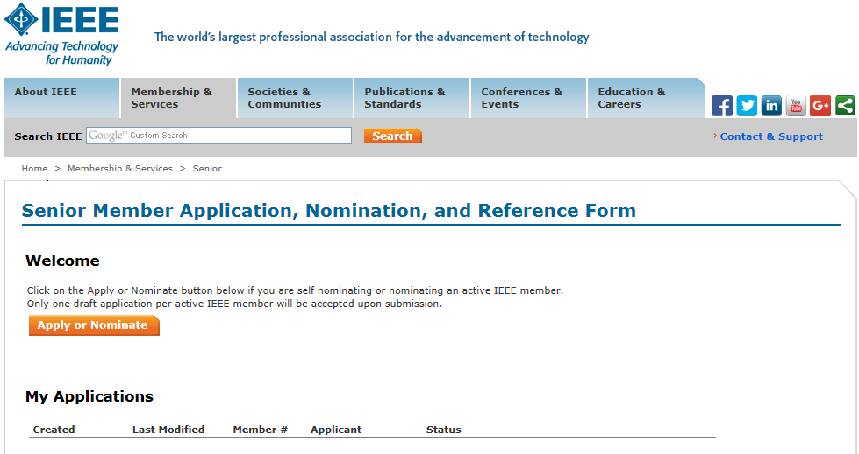
Where to Apply
Resume, Professional History and References entered here:
https://www.ieee.org/membership_services/membership/senior/application/index.html

Slide 10
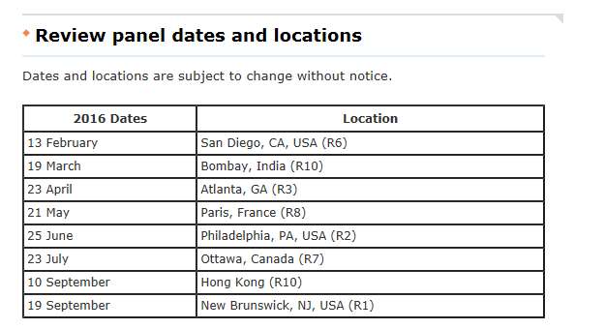
Review Dates
ten days prior to the meeting date

Slide 11
Senior Member Benefits
Recognition: The professional recognition of your peers for technical and professional excellence.
Senior member plaque: Since January 1999, all newly elevated Senior members have received an engraved Senior Member plaque to be proudly displayed for colleagues, clients and employers to see. The plaque, an attractive fine wood with bronze engraving, is sent within six to eight weeks after elevation.
US$25 coupon: IEEE will recognize all newly elevated Senior members with a coupon worth up to US$25. This coupon can be used to join one new IEEE society. The coupon expires on 31 December of the year in which it is received.
Letter of commendation: A letter of commendation will be sent to your employer on the achievement of Senior member grade (upon the request of the newly elected Senior member).
Announcements: Announcement of elevation can be made in section/society and/or local newsletters, newspapers and notices.
Leadership Eligibility: Senior members are eligible to hold executive IEEE volunteer positions.
Ability to refer other candidates: Senior members can serve as a reference for other applicants for senior membership.
Review panel: Senior members are invited to be on the panel to review senior member applications.
US$25 referral coupon: Newly elevated Senior members are encouraged to find the next innovators of tomorrow and invite them to join IEEE. Invite them to join and the new IEEE member will receive $25 off their first year of membership.

Slide 12
Questions?

