Slide 1
2016-10-12 | VT PES
ISO-NE Synchrophasor Related Projects
Business Architecture and Technology (BAT)
Frankie Qiang Zhang
Senior analyst

Slide 2
Synchrophasor Architecture
PMU Data
SCADA Data
Simulation Results
Phasor Analytics
Offline Study
Other Information
Model Validation
(plant level & system wide)
Modes
PhasorPoint
Event Detection
Alarm Emailing Service
Alarm / SQL
SQL
Alarms / SQL
Alarm
ISO-NE PDC
Online TSAT
Oscillation Source
Webpage
Oscillation Source Detection
Oscillation Energy Flow
Initial Condition
PMU Calibration
ROSE
EMS
Hybrid SE
ISD
Phasor SE
Data Quality
Alarms / Statistics
Data Quality
Webpage
DQMS
PI
C37.118 / EINET
SCADA
PMU/TO-PDC
External PDC

Slide 3
Operational use
Operations Support

Slide 4
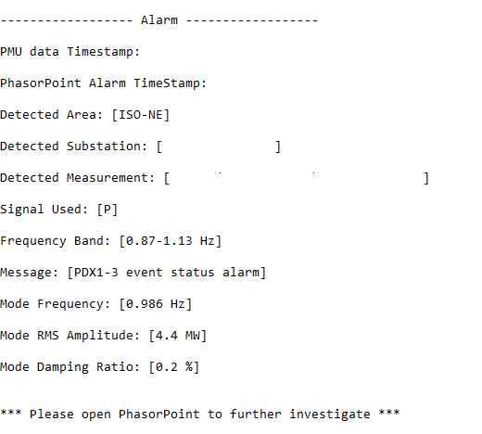
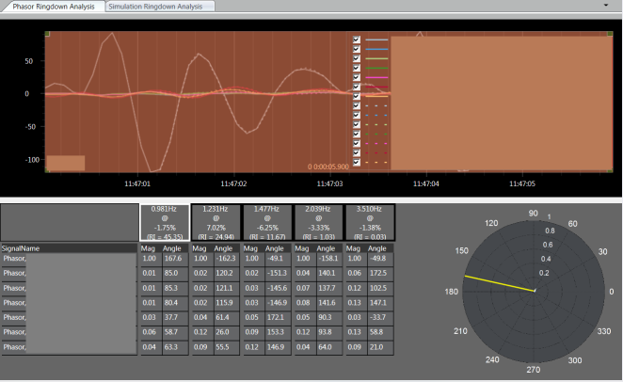
Operational Use
Real-time Oscillation Alarm --> Email
  Operation support engineers
    Write real-time operating procedures
    Communicate with the plant
Post Event Analysis
  Data: PMU, SCADA, DFR
  TSAT simulations
  PhasorAnalytics
Frequency Response Monitoring
  System
  Individual generator
  In-house developed Excel tool
  Evaluating PNNL’s Frequency Response Tool

Slide 5
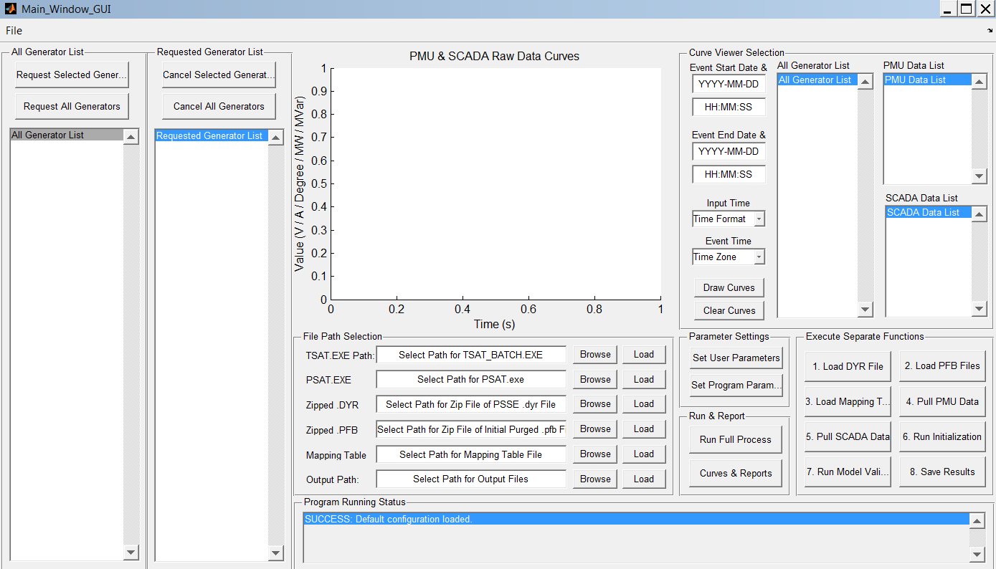
Power Plant Model Validation
(MOD-26 & MOD-27)
Batch Model Validation – 19 generators/plants with 1 click
  A MATLAB tool calls TSAT playback function

Slide 6
System Wide Model Validation (MOD-33)
In-house developed bridging tool – Java
  Carries over real-time SE statuses to the planning case
  Compare power flow and simulation results with SE/PMU data
  Identify mismatches and investigate model accuracy
SE Case
NX-9 Mapping
Bridging Tool
Modified Planning Case
Planning Case

Slide 7
Pilot On-line Transient Stability Assessment
Real-Time security assessment
Post event analysis
  Good matching with PMU
  as the starting point
  Event recreation
  Perform what-if analysis

Slide 8
R&D
R&D Department (BAT)

Slide 9
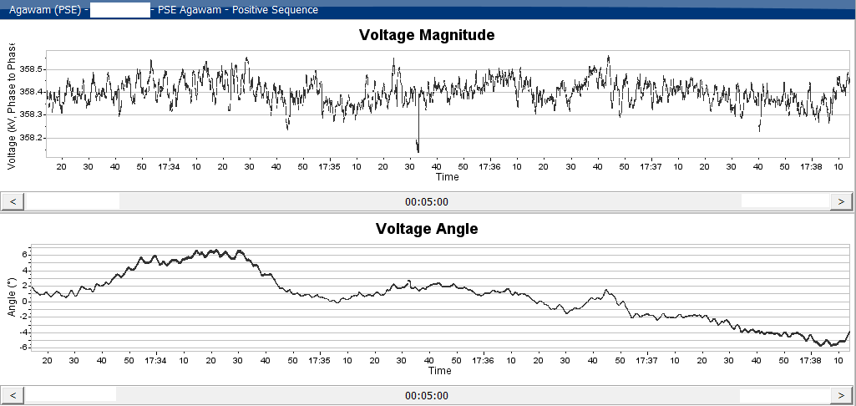
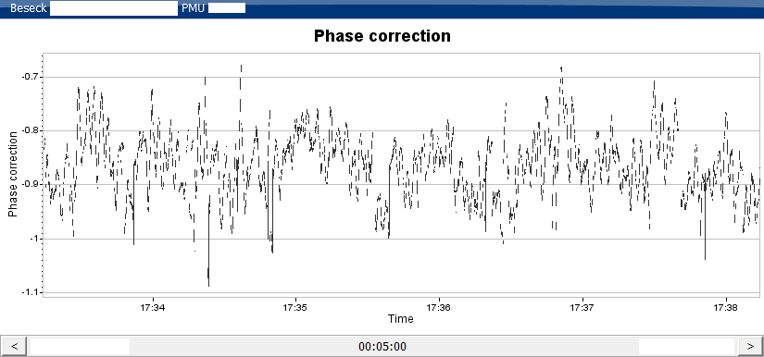
Collaborations with Academia
RPI’s Phasor Only State Estimator (PSE)
  Deployed in development openPDC & PhasorPoint
    Estimated values
    Pseudo measurements
    Angle biases

Slide 10
Collaborations with Academia – continued
Research project on cloud hosted WAMS
  Phase I: PSERC supplemental project with WSU & Cornell (finished)
    PSERC Seminar on Sep. 13th
  Phase II: NYSERDA project with NYPA + ISO-NE (ongoing)
Security
Latency
Consistency
Fault-tolerance
Cost

Slide 11
Collaborations with Academia – continued
DOE Sponsored Eastern Interconnection Baselining Study
  EPG/PNNL/ISO-NE/PJM/NYISO/MISO
Research with EPRI on static load modeling using PMU data
Disturbance Identification and Characterization

Slide 12
In-house R&D – Oscillation Monitoring Strategy
Oscillation Alarm Emailing Tool
  Java program
Online records (shared document)
  Tracking events triggered oscillation Alarm
  Individual event analysis
Baselining studies by GE in 2012 and 2014 (PhasorAnalytics)
  Recommendations on Frequency sub-bands, signal selection for monitoring and alarm thresholds
Alarm thresholds
  Adjusted in 2015 based on operational/security concerns
  An ongoing process, e.g., higher thresholds for known issues
Signal selection for monitoring/alarming
  Mostly on generators (POI)
  Key tie-lines and interfaces

Slide 13
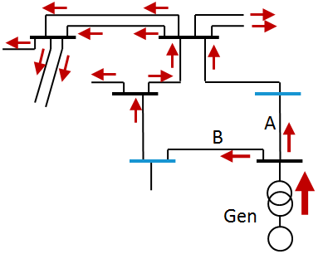
In-house R&D – Oscillation Source Location (OSL) tool
MW flow in line B
Dissipating energy flow at the bus of the source
Dissipating energy flow in 345 kV network
PMU measurements
Oscillation Source Locating tool

Slide 14
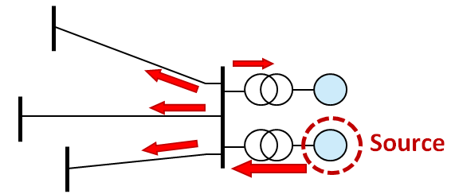
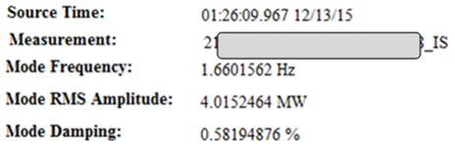
In-house R&D – Oscillation Management
Identification of Source is
Actionable Information
Email Notification
Source: xxx
Triggered by Alarm
Operations Support
Engineering analysis
Real-time OP
Call power plant
PhasorPoint
Monitoring
Alarms
Source Location
In-house Program or
Part of PhasorPoint
Control Room
Operating Procedures
Re-dispatch Generators
EMS
(Alarms)

Slide 15
In-house R&D – Other
PMU + SCADA Hybrid State Estimation
  Development EMS
Data Quality Monitoring System v2.0
  openPDC Adapter
Line parameter estimation & digital PMU calibration
WAMS baselining for external PMU data

Slide 16
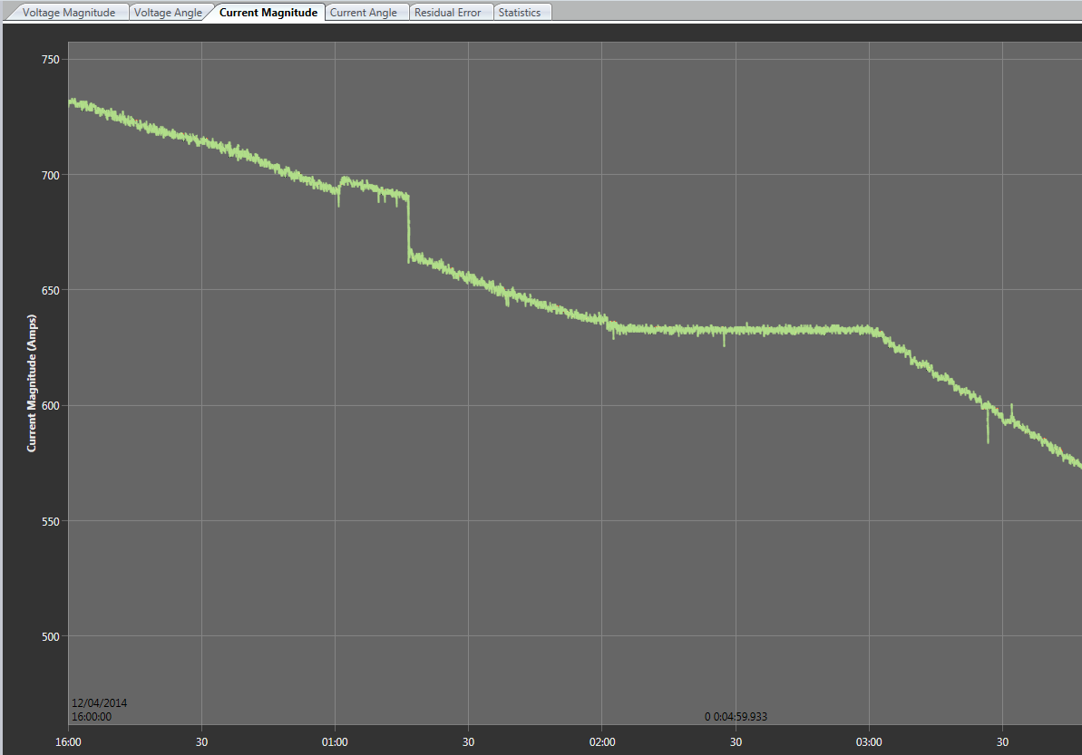
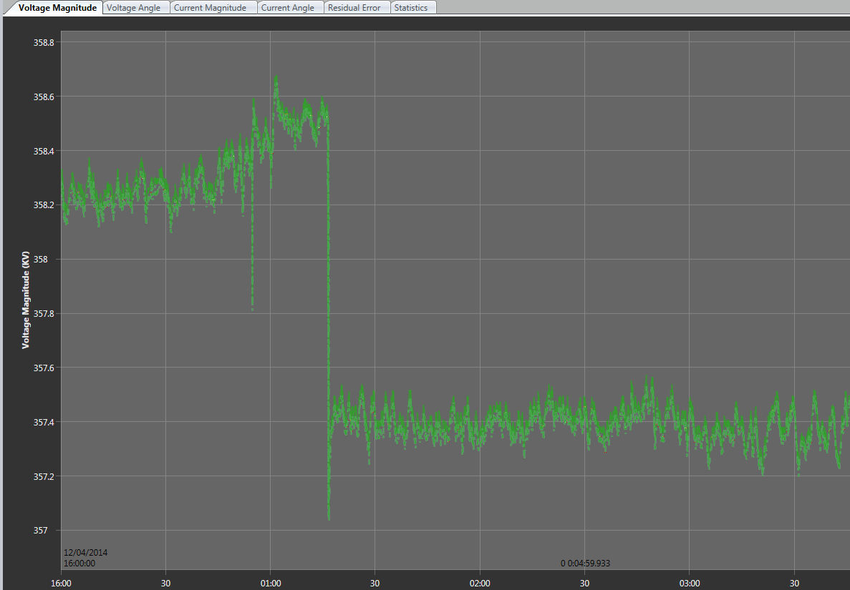
R&D with Vendors
Linear State Estimator (LSE) Evaluation with GE/WSU
  Now part of PhasorAnalytics

Slide 17
Other Ongoing Efforts
PMU data exchange with NYISO, PJM and MISO in 2016
Operating procedure (OP-22) change to request more PMU installations in transmission substations
Proposing to require TOs to install additional PMUs at
  All new 345 kV substations
  POI for all new generator sites with 100 MVA and above
  POI for all existing generator sites with 100 MVA and above

