Slide 1

2016 Phasor Measurement Applications
October 12th, 2016

Slide 2


IEEE PES Green Mountain Section Contacts
Chair: Jeff Carrara JCarrara@velco.com
Vice-Chair: Josh Burroughs JBurroughs@velco.com
Treasurer: Diana Lee Dlee@velco.com
Webmaster: Lou Cecere LCecere@velco.com
Secretary: Lou Cecere LCecere@velco.com
Tech Mtg Coord: Bernadette Fernandes BFernandes@velco.com
Please contact us if you are interested in volunteering, offering a meeting idea or otherwise getting more involved
http://sites.ieee.org/gms-pes/
http://resourcecenter.ieee-pes.org/
http://www.ee-scholarship.org/
http://www.ieee-pes.org/pes-communities/students
http://pes-careers.org/
Notes:
This Society was founded almost 125 years ago with the mission of serving the members of our profession.
Our mission is to be the leading provider of scientific and engineering information on electric power and energy for the betterment of society and the preferred professional development source for our members.
Our mission going forward will continue to be the same while our profession faces an environment of rapid and often breathtaking change.
Our task is to address the many challenges that lay before us. To do this, we need to take advantage of our heritage and strengths while aggressively pursuing opportunities that will enable us to continue another 125 years and beyond.

Slide 3
Summary of Last Year
Feb 19th
  “Understanding and managing the impacts of PEVs on the electric grid”
  “Drive Electric Vermont-Partnering for Plug-in Vehicle Adoption in the Green Mountain State”
Mar 16th “The Future of Energy: Smart Grid and Beyond”
May 14th Highgate HVDC Converter Tour
Sept 17th PES Technical Seminar & Stafford Hill Solar Tour
  “DG Interconnection Issues concerning IEEE 1547 and UL 1741”
  “Energy Storage Systems”
  “Renewable Generation Forecasting”
Dec 4th “Smart Grid Innovation in Vermont” and Awards Ceremony

Slide 4
This Year, 2016
Jan 27th - Norwich University, “Engineering: College to Career”
Feb 23rd - 2016 Kickoff Meeting
April 21st – UVM IGERT (http://www.uvm.edu/smartgrid/)
May 2nd – 5th – IEEE PES T&D Conf. & Expo. In Dallas
  (http://www.ieeet-d.org/)
May 13th – Weidmann (http://www.weidmann-electrical.com/en/)
  Transformer Electrical Insulation, Plant Tour (St. Johnsbury)
June 23rd – VT Weather Analytics
July 17th – 21st - IEEE PES General Meeting in Boston
  http://www.pes-gm.org/2016/
August 24th - Kingdom Community Wind tour
October 12th – Phasor Measurement Applications
December - Annual IEEE Green Mountain Section Awards Ceremony

Slide 5
Phasor Measurement Applications
Tonight’s Agenda
Time | Topic | Speaker
5:00pm | Pizza & Networking
5:15pm | IEEE PES, Power System Phasor fundamentals and VELCO | Jeff Carrara VELCO
5:30pm | A Knowledge-based Approach to Situational Awareness for the Power Grid using Synchrophasors | Chumki Basu IBM Research
5:50pm | Statistical Early Warning Signs of Instability in Synchrophasor Data | Paul Hines UVM
6:10pm | ISO New England Synchrophasor Related Projects | “Frankie” Qiang Zhang ISO-NE
6:30pm | Adjourn

Slide 6
Traditional Telemetry & SCADA
Supervisory Control And Data Acquisition (SCADA)
  Control Center polling information from many remote sites every 2 seconds
  Magnitude of Watts/VARs (kilo/Mega), Voltage (kV), Amps, Frequency (Hz) – analog vs digital transducers or relays
  Status of circuit breakers & disconnects (open/closed)
  Status & Alarms of main circuit equipment as well as protection, monitoring & control systems
  Control: open/close of breakers/disconnects, voltage control by transformer tap change, capacitor/reactor switching or set-point of dynamic VAR facilities & block/restore automatic reclosing

Slide 7
Traditional State Estimator
Inputs:
  Network Model (impedances and connections)
  Measurement magnitudes (Real & Reactive Power, Voltage & maybe current)
  Circuit breaker or disconnect switch statuses
Modeling is Iterative: Time & Risk of Divergence
Results:
  Voltage & Current Phasors (magnitude & angles)
  Power Flow (Real & Reactive)
  Determination of Flawed Measurements, Network Impedances or Breaker/Disconnect Statuses

Slide 8
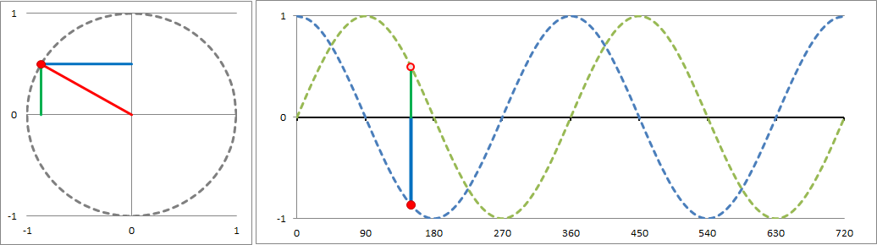
Phasors
A phasor is a complex number (a+jb) representing a sinusoidal function whose magnitude (M), angular frequency (ω), and initial phase (θ) are time-invariant.
Ph(t) = M*[cos(ωt+θ) + j sin(ωt+θ) ]
A phasor in polar/rectangular form has ccw rotation where the real component is shown +/- x and imaginary +/- y
t or Ø
t or Ø

Slide 9
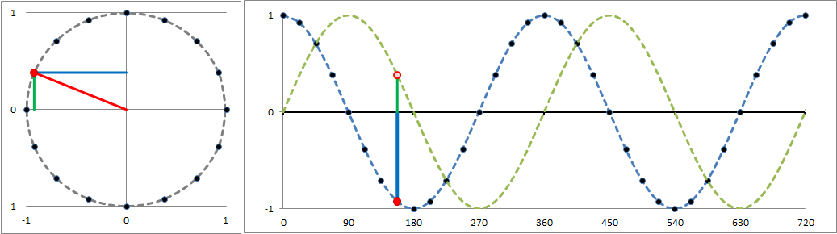
Power System Phasors
In T&D many devices are measuring voltage and current (real) values over time and determining their phasors.
While analog transducers convert the power (magnitude) to SCADA, digital (microprocessor) meters and relays convert these values into phasors in phase domain and sequence* domain
In the past digital relays would only use the phasors for its own operation and may record this information for a fault. Original relay records may include 4 data points per cycle (16.7ms), then 16 samples per cycle (shown above). Modern devices, especially DFRs & PMUs sample even faster

Slide 10
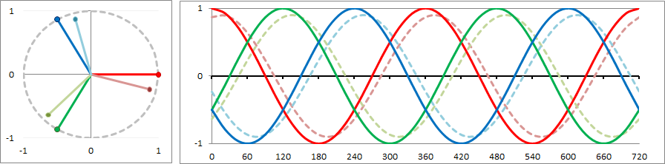
Power System Phasors
continued
In Transmission and part of the distribution system there are 3 phase conductors offset by 120° (5.56ms at 60Hz). Each with Current & Voltage
While the higher voltage systems is mostly balanced the above 6 phasors can be summarized by “positive sequence” voltage and current (2 phasors). (Unbalance would be reflected in negative & zero sequence)
While SCADA polls every 2 seconds phasors data is either sent 30 or 60 times a second so a reduction in phasors can help avoid transmitting, processing & storing excess data.

Slide 11
Accuracy
The IEEE Standard for Phasors C37.118 covers not only accuracies of magnitude (as traditional measurements) but time/angle as well.
This put a higher importance to the source of time. In the past time was only important for after the fact comparison of data though now it is critical for this real-time function. e-Loran
Because phasors across an interconnection have to be on the same time base (“Synchro”-phasors) and phase angle which is based upon it. The accuracy of time is a new focus, including 61850 where devices may share phasors.

Slide 12
Communications
Unlike SCADA which most commonly polls/responds every 2 seconds Phasor data is streamed continuously once initiated and as such is a fixed amount of bandwidth
Latency of data path requires buffering of data of sites that are received sooner so as to process data of the same timestamp together
Due to differences in latency, especially changes, loss of data can delay processing of buffered data
Corrupted data is less of a concern in modern systems

Slide 13
Phasor Devices & Network
Phasor Measurement Unit (PMU). Dedicated or built into DFR, meter or relay.
Phasor Data Concentrator (PDC). Device at substation (optional) or server in network to collect and in most cases retransmit (share) phasors to higher level, or peer, PDCs
PDC
PDC
PDC
PDC
PDC
PDC
PDC
PDC
PDC
PMUs
PMUs
PMUs
PDC
PDC
PDC
PMUs
PMUs
PMUs
PMUs
PMUs
PMUs

Slide 14
Phasor Application Summary
Source: “Synchrophasor Technology – PMU Use Case Examples”
Sarma (NDR) Nuthalapati, PhD (Texas A&M) and Bill Blevins (ERCOT)
2016 IEEE PES General Meeting, Boston, July 17-21, 2016

Slide 15
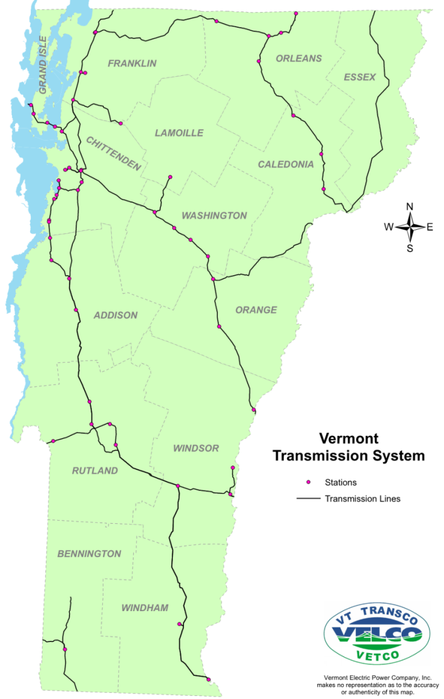
PMU Installations in VT
Existing:
  * Vernon 345 kV
    * 345 kV Newfane, Coolidge & NH/MA
  * West Rutland 345 kV
    * 345 kV Coolidge & New Haven & 115 kV
Install w/ Capital Project
  * Ascutney (2017)
    * 115 Coolidge, Windsor & NH
  * Grand Isle Terminal (2018)
    * 115 NY & S. Hero
Other Installs (2017)
  * West Rutland 115 kV
    * 115 Blissville, Florence & N. Rutland
  * Granite 115 & 230 kV
    * 115 Barre, Chelsea & 230 Comerford (NH)
  * Highgate Converter North (120) & South (115)
    * HQ vs ISO-NE

Slide 16
Potential Phasor Applications in VT
Oscillation detection (generator, etc)
Angular relationship to interfaces
  Stability / Stress
  Angles across breakers / system during reclose
Portable PMU for system verification
  Line Impedances
  Generator performance
  Etc.
Phasor-Linear State Estimation
  Hybrid w/ traditional measurements
Research into new applications based upon work with partners

Slide 17
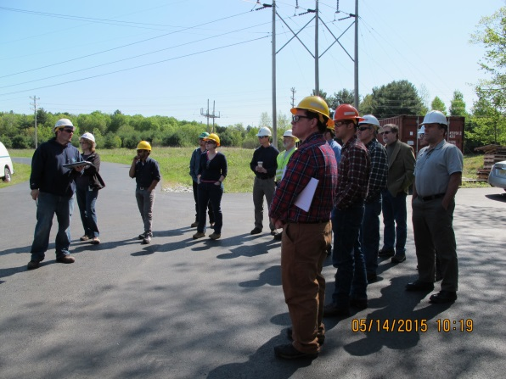
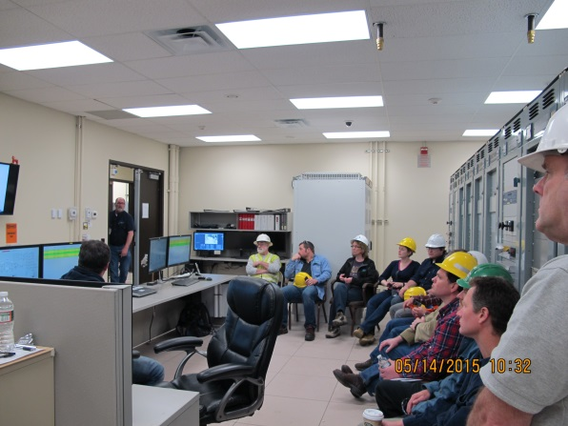
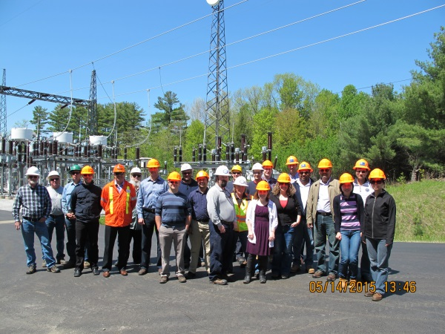
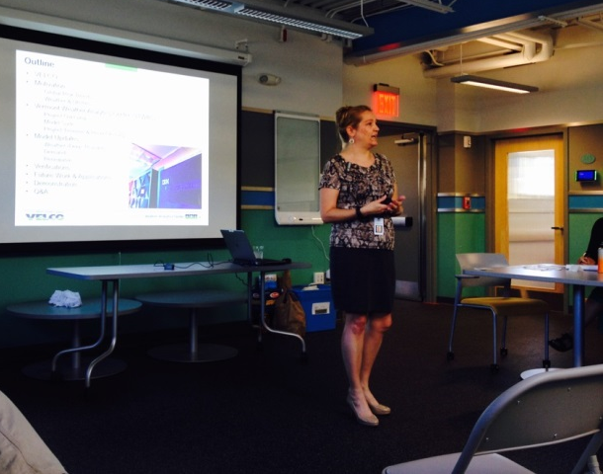
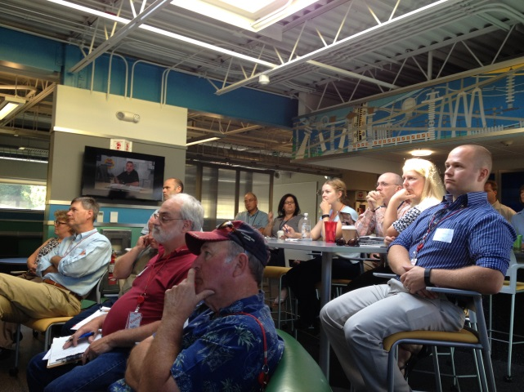
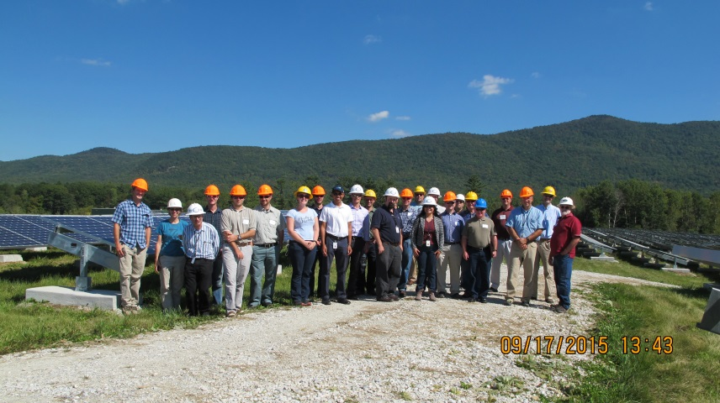
Questions?
Notes:
Top is Highgate, bottom is Technical Seminar and Stafford Hill

