Slide 1
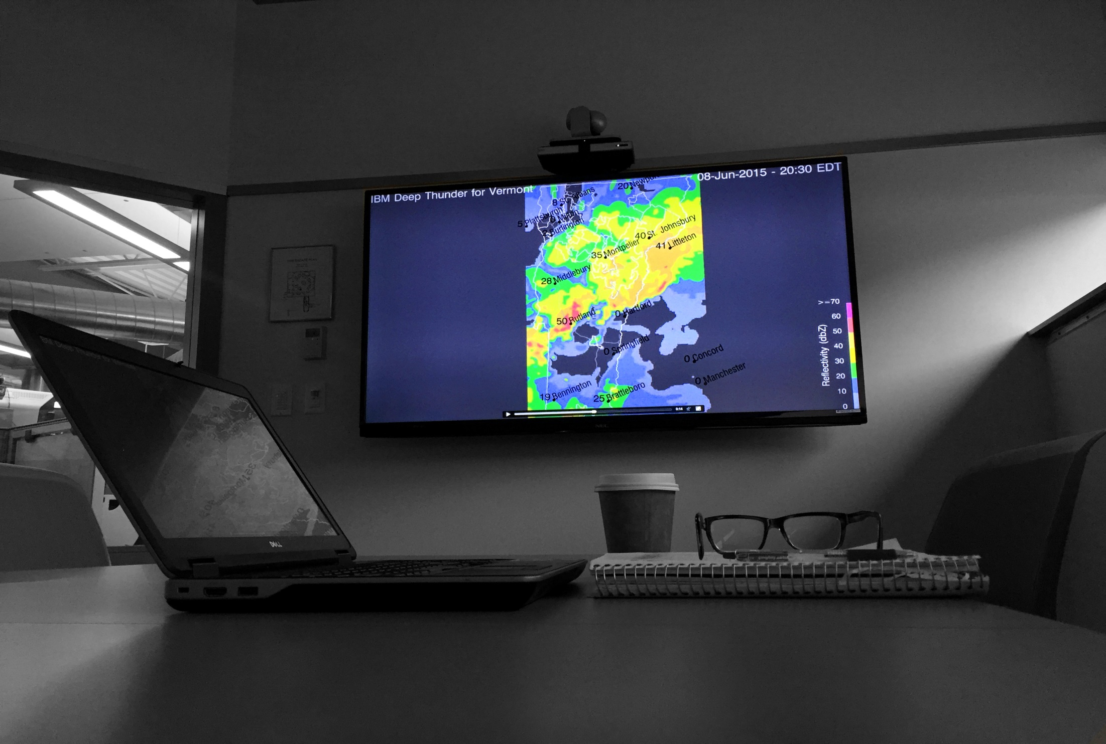
Vermont Weather Analytics Center
Mary E. Coombs
Project Manager
VELCO

Slide 2
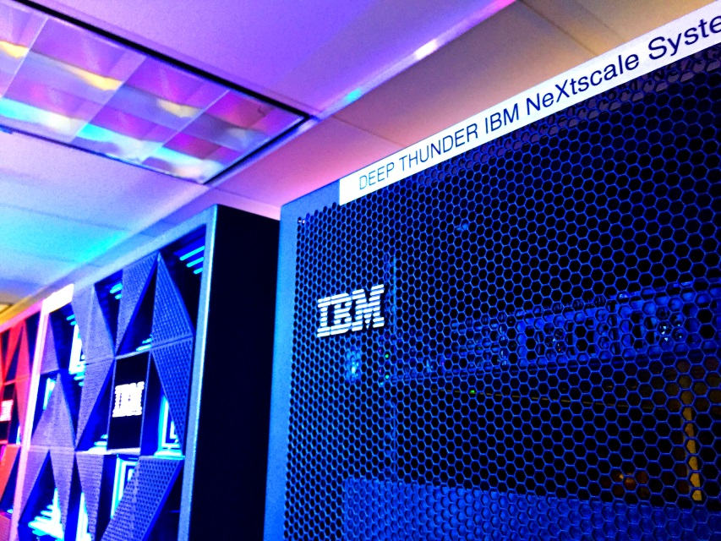
Outline
VELCO
Motivation
  Global Risk Trends
  Weather & Utilities
Vermont Weather Analytics Center (VTWAC)
  Project Overview
  Model Suite
  Project Timeline & Recent Activity
Model Updates:
  Weather (Deep Thunder)
  Demand
  Renewable
Verifications
Future Work & Applications
Demonstration
Q&A

Slide 3
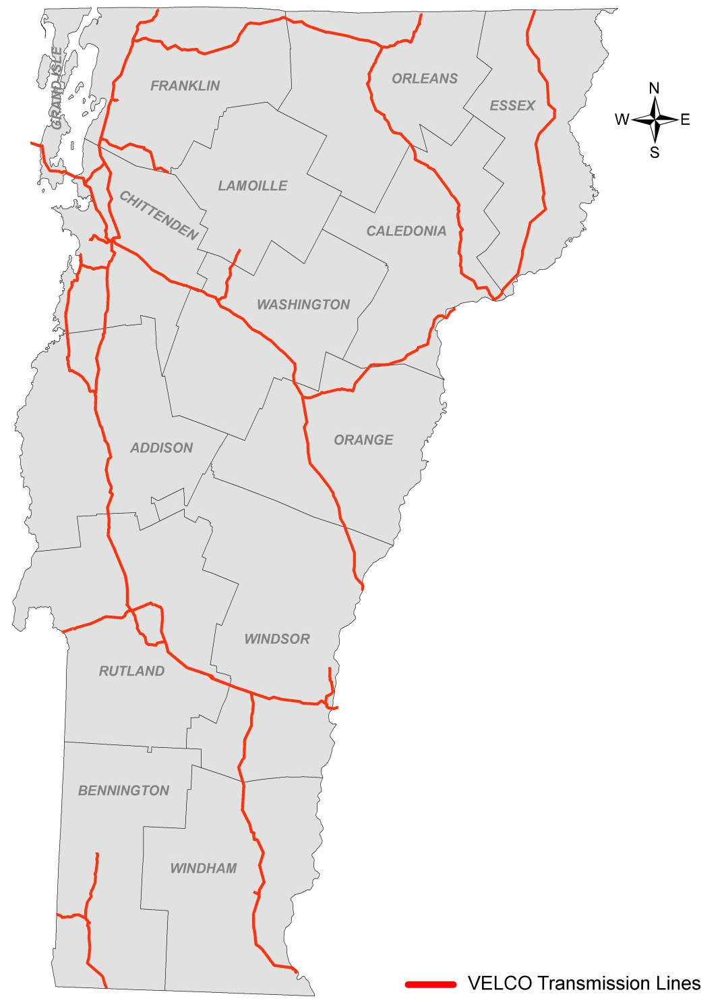
Background
VELCO
Vermont Electric Power Company (VELCO) was founded in 1956 when local utilities joined together to create the nation’s first “transmission only” electric company
VELCO operates an interconnected electric transmission grid consisting of:
  738 miles of transmission lines
  13,000 acres of rights-of-way
  55 substations, switching stations, and terminal facilities
  1,300 miles of fiber optic communication network
  Equipment that enables interconnected operations with Hydro-Québec
VELCO: Vermont’s transmission reliability resource

Slide 4
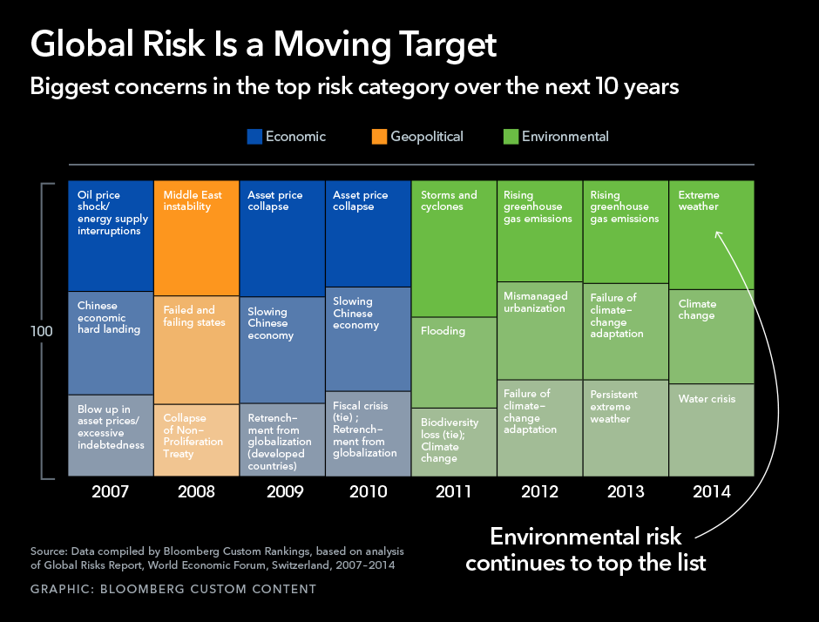
Motivation
Global Risk Trends

Slide 5
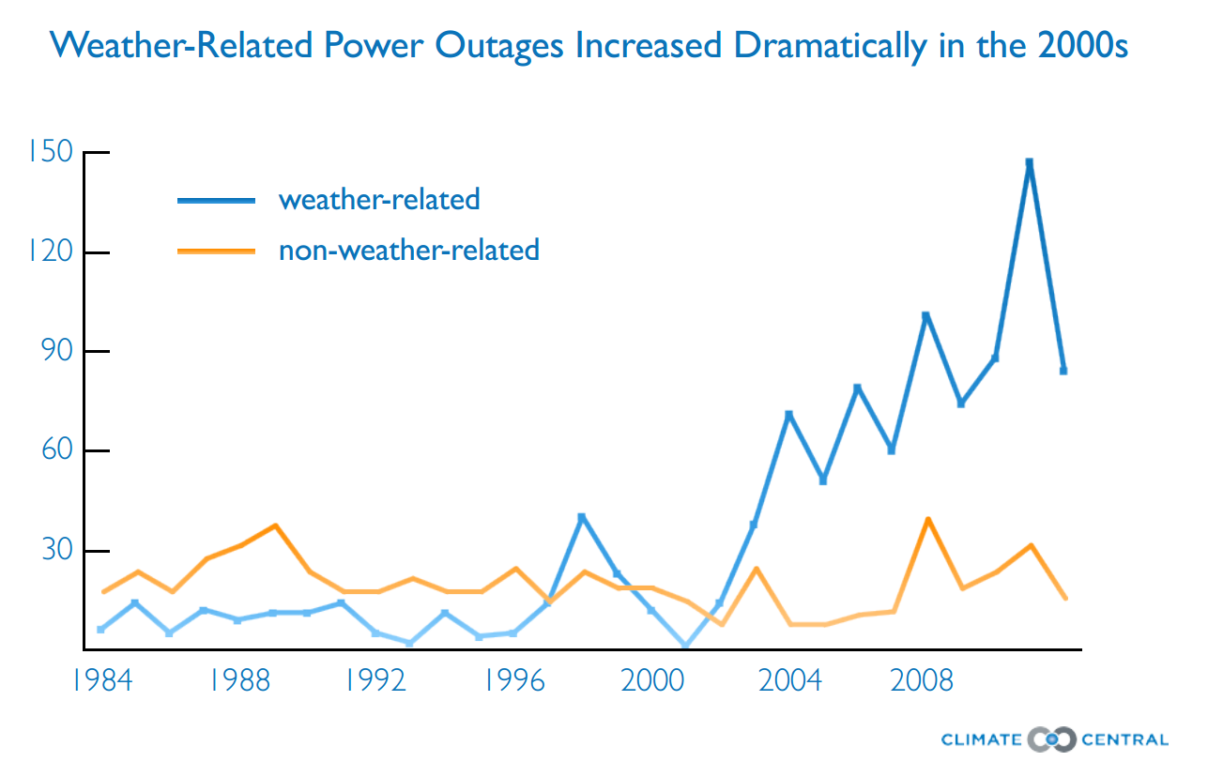
Motivation
Weather & Utilities
Source: “Blackout: Extreme Weather, Climate Change and Power Outages” (Climate Central)

Slide 6
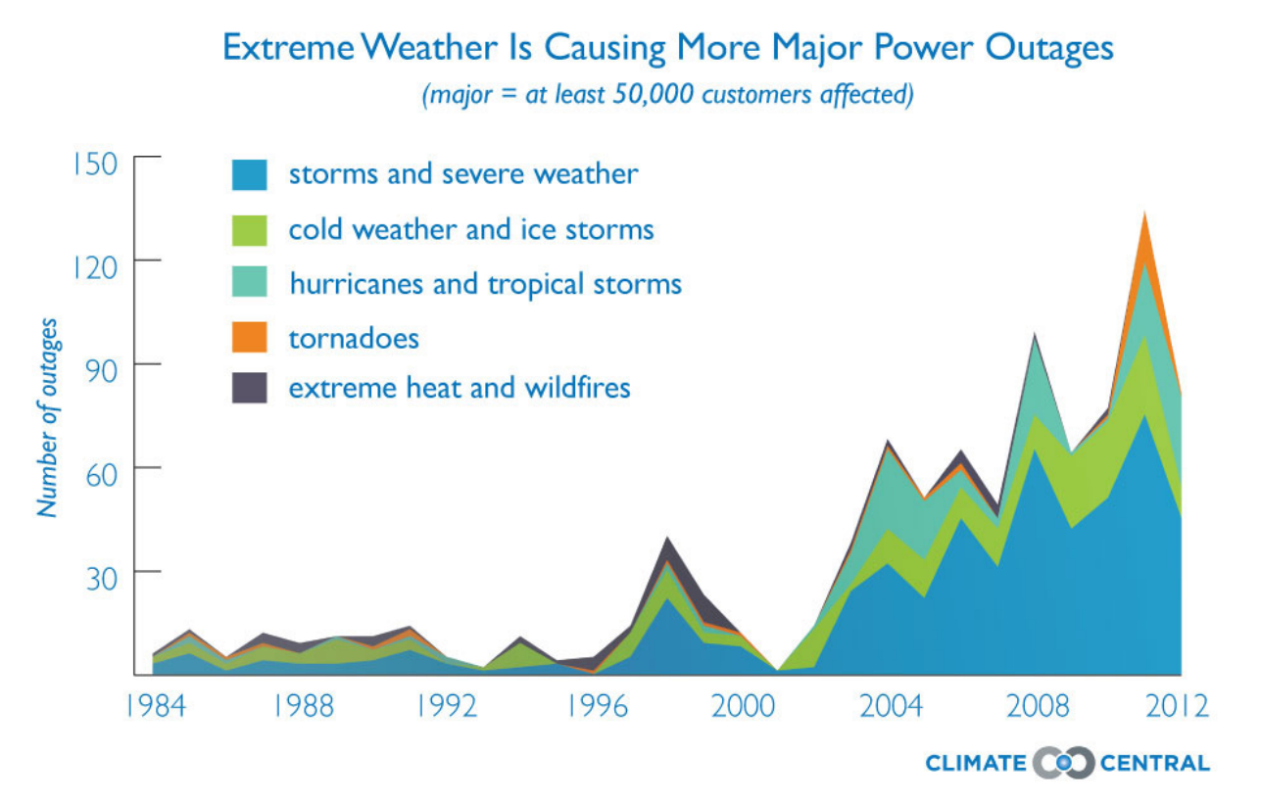
Motivation
Weather & Utilities
Source: “Blackout: Extreme Weather, Climate Change and Power Outages” (Climate Central)
Notes:
A tenfold increase in major power outages (those affecting more than 50,000 customer homes or businesses), between the mid-1980s and 2012.
Non-weather related outages also increased during that time, but weather caused 80 percent of all outages between 2003-2012.

Slide 7
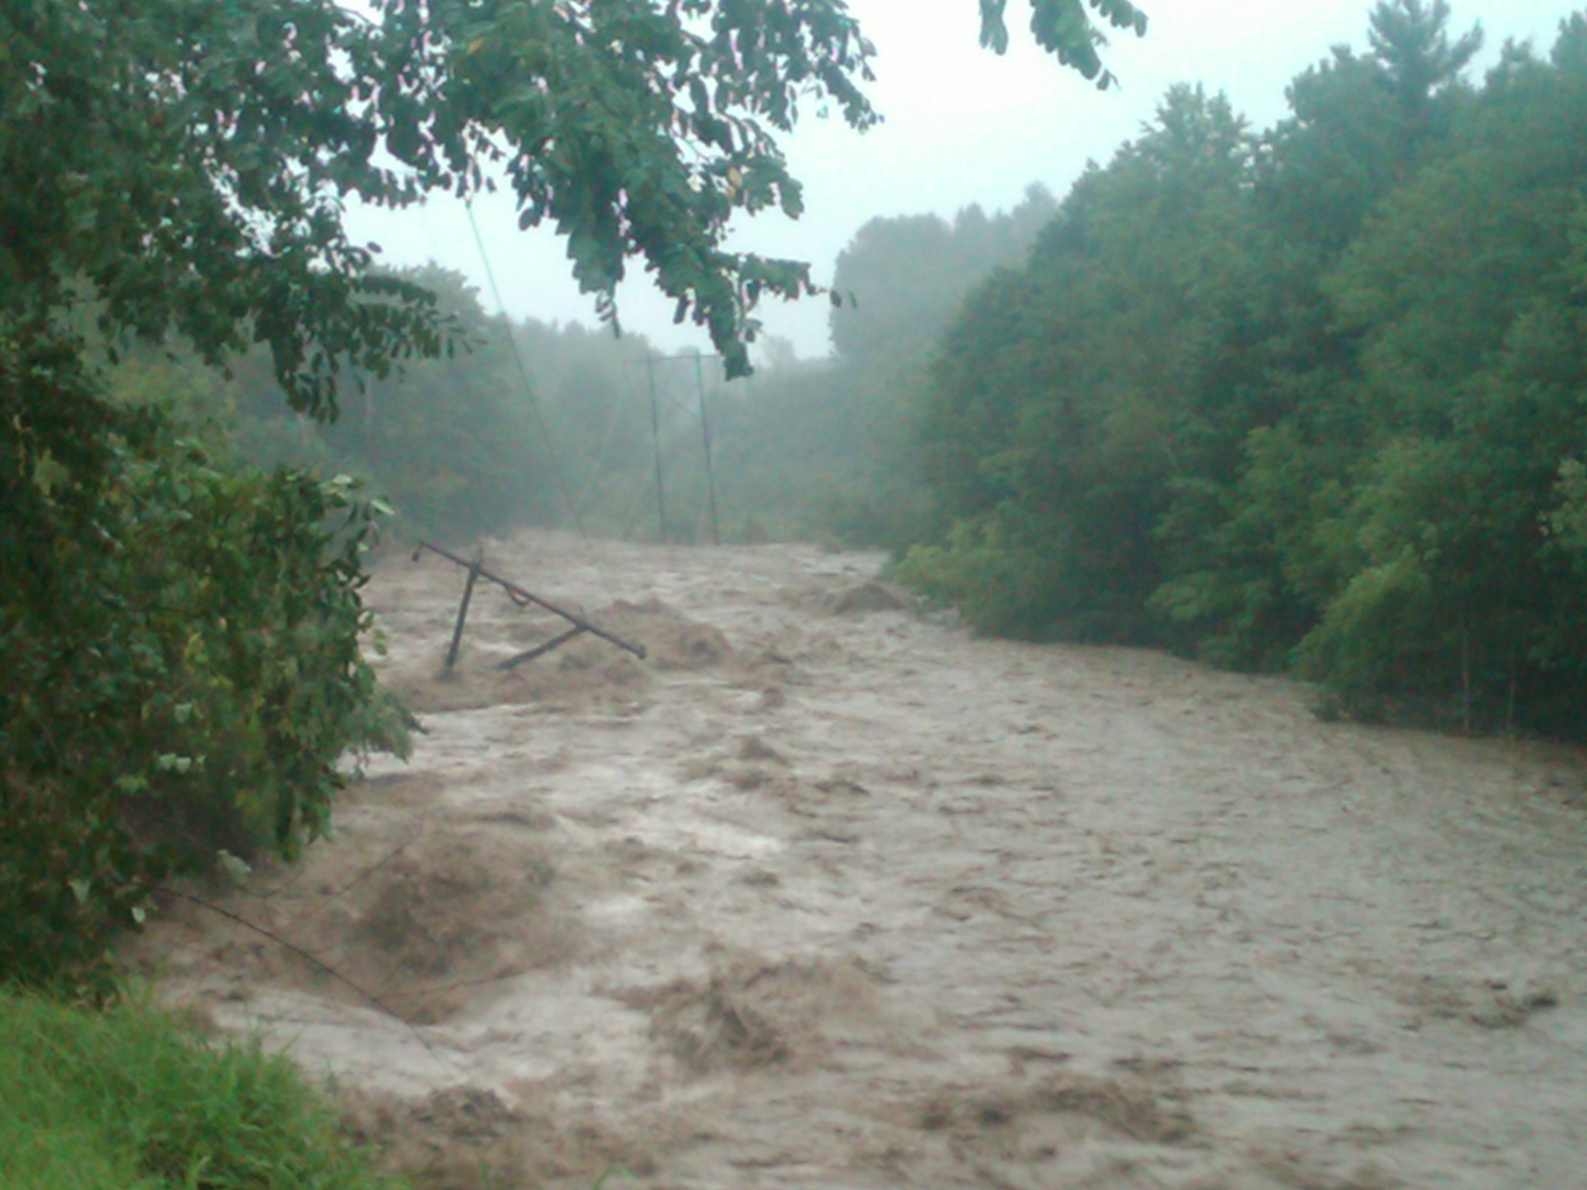
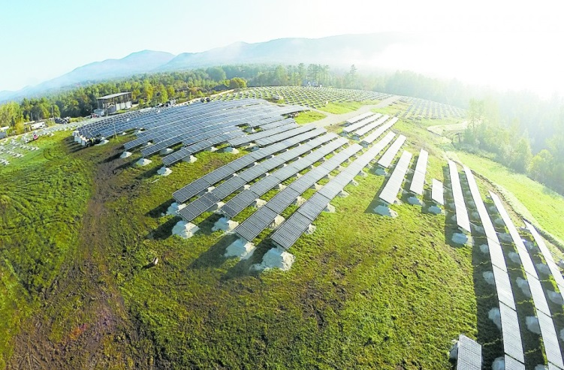
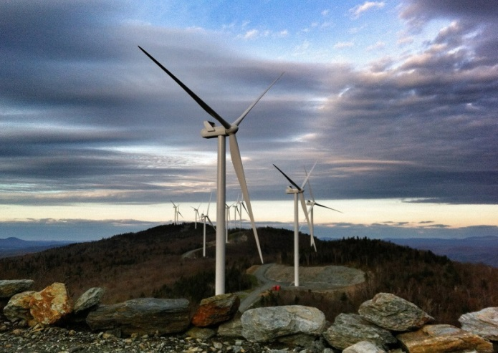
Vermont Weather Analytics Center (VTWAC)
Project Overview
Two-year, $16 million research undertaking to develop intellectual property using coupled data models and related software
2-year agreement/partnership with IBM
3 main goals:
Increase grid reliability
Lower weather event-related operational costs
Optimize utilization of renewable generation resources
Notes:
Irene –cold river K32, KCW

Slide 8
Vermont Weather Analytics Center (VTWAC)
Models
Renewable Sensor
Data
Renewable Generation
Weather
Data
Weather Model
Wind
Solar
Renewable
Integration
Power Data
Electric Demand
Meter
Data

Slide 9
Vermont Weather Analytics Center (VTWAC)
Model Suite & Timeline
Deep Thunder
Demand
Renewable
Renewable Integrated Stochastic Engine (RISE)
Model | Function
Weather (Deep Thunder) | To produce accurate weather forecasts up to 48 hours in advance down to 1 sq. km → Lower weather event costs
Demand | To increase accuracy of state load forecasts → Better plan for future needs
Renewable | To produce generation forecasts for solar and wind farms → Improve power supply/planning
Renewable Integration Stochastic Engine (RISE)* | To integrate the models’ results to optimize the value of Vermont's generation, demand response, and transmission assets
*VELCO Only

Slide 10
Vermont Weather Analytics Center (VTWAC)
Project Timeline & Recent Activity
Operational
2/2016
Prove Out
6/2015 – 1/2016
Development
2/2014 – 5/2015
Today
Project is currently in prove out stage with Weather, Demand, and Renewable models live
Recent events:
  June 16-18: Project team participated in IBM’s Smarter Energy Research Institute (SERI) conference and was voted best demonstration by conference attendees
  August 13-14: Hosted the Weather & Energy Innovation Workshop in Burlington through Deep Thunders Users Group. Workshop participants included ConEd, DTE, SDG&E, HQ, LSC, Norwich, and VT-DU’s
  August 17-18: VTWAC portal tutorials were held at VELCO and GMP-Colchester
Hardware/software strategy:
  Enabled web portal to operate from inside VELCO’s firewall
  Secured scope of services and pricing options from IBM for support beyond current contract
  Engaged in next round of discussions with Lyndon State, UVM and Norwich regarding hosting Deep Thunder

Slide 11
Weather (Deep Thunder)
Deep Thunder
Demand
Renewable
Renewable Integrated Stochastic Engine (RISE)
Developments
Increased horizontal resolution to 1 km (previous: 2 km)
Increased vertical resolution levels from 19 to 51 to reflect various turbine heights
Added numerous site-specific forecast for renewable generators (KCW, Post Road solar, etc.) and VT-DU main offices (GMP-C, GMP-R, VEC, WEC, Stowe, etc.)
Added service territory-specific portal views (GMP, VEC, WEC, and Stowe)
New weather variables added such as Lightning Potential Index and Snow-to-Liquid ratio
Installed 8 weather stations as part of the VTWAC mesonet (additional stations from VEC and UVM)
Next steps
Complete installation of 5 remaining weather stations and enable data streams into DT
Develop and implement Weather InSights Environment (WISE) visualization tool for Vermont Deep Thunder
Create “Forecaster Discussion” tab to allow forecaster and Deep Thunder users the opportunity to discuss Deep Thunder forecasts
Complete model validation

Slide 12
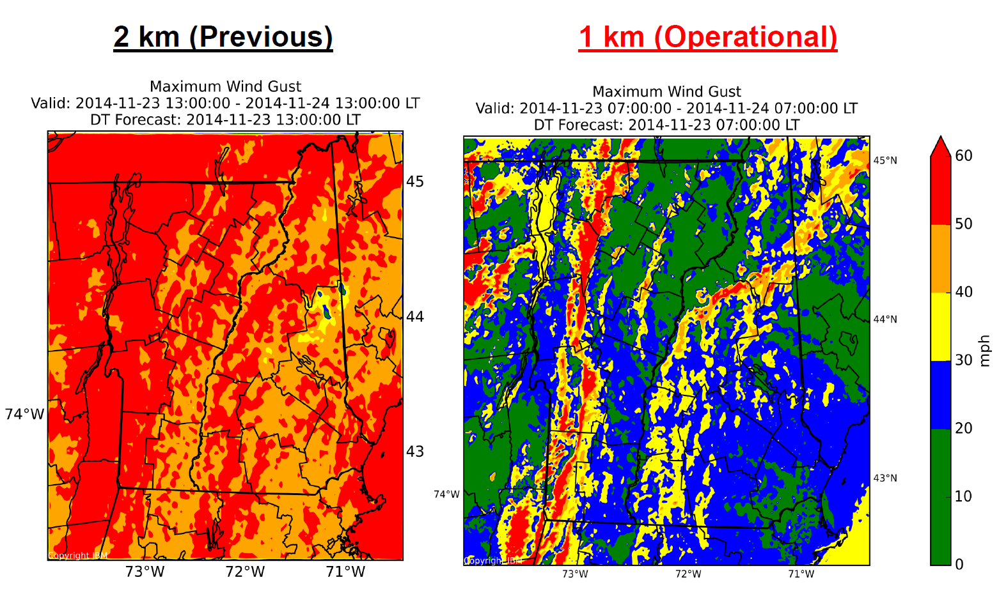
Weather (Deep Thunder)
1km version performs significantly better wind forecasts by capturing local topographic features, such as mountains (Greens, Adirondacks, Mt. Washington) and lakes (Lake Champlain, Lake George)

Slide 13
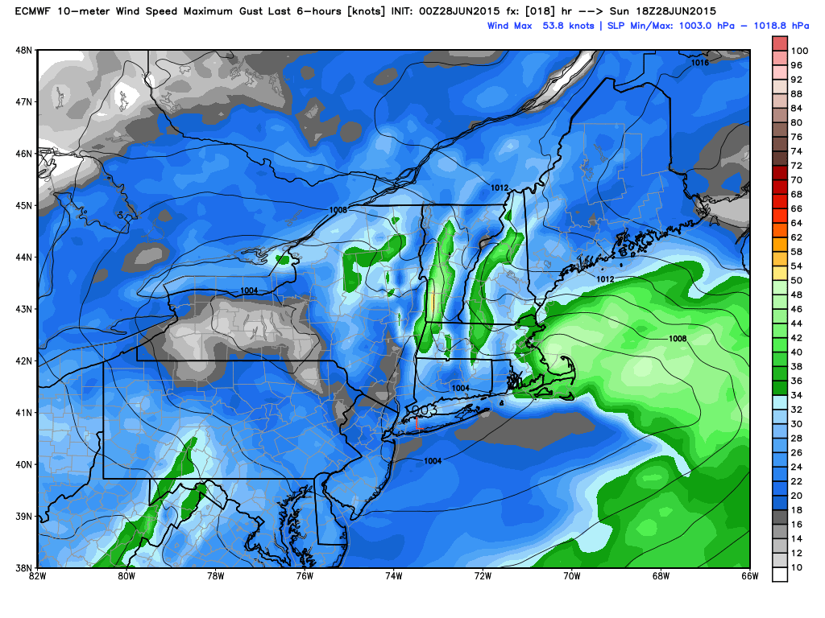
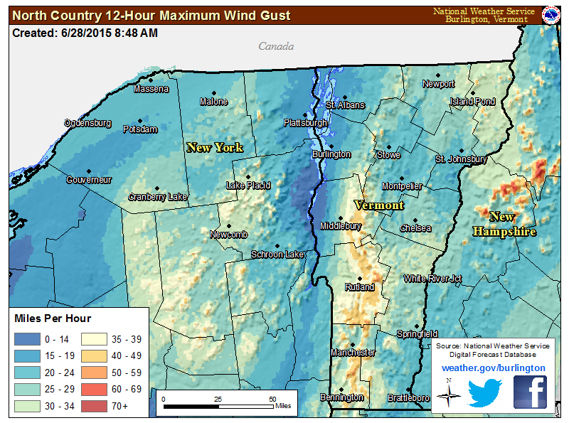
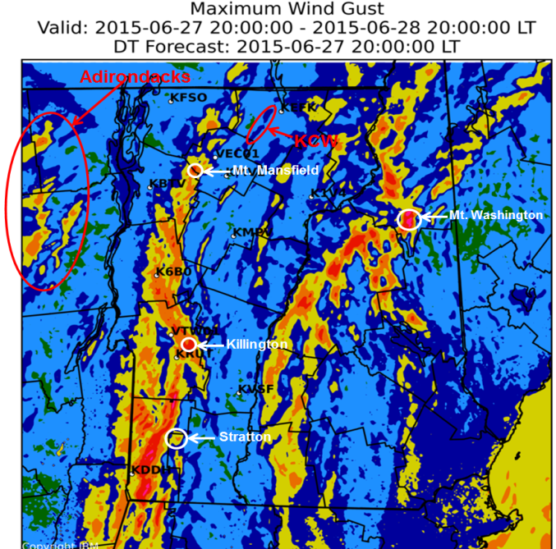

Weather (Deep Thunder)
European (ECMWF) [16km]
Forecasted Wind Gusts – 6/28 Wind Event
NWS [4km]
Deep Thunder [1km]
Increased Resolution

Slide 14
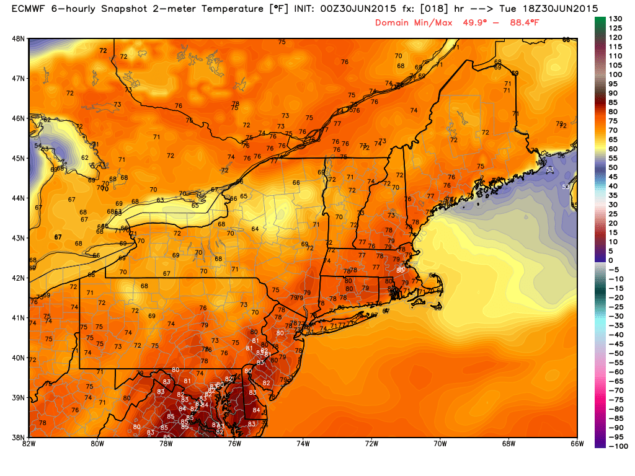
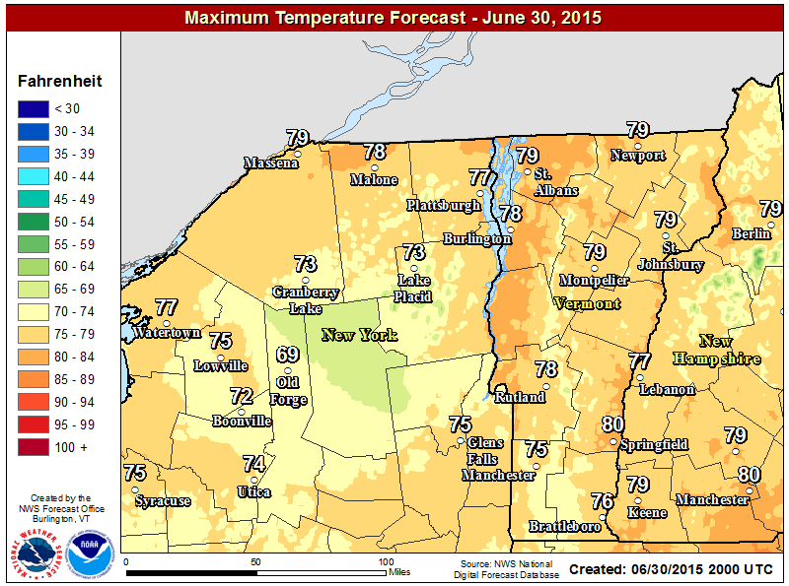
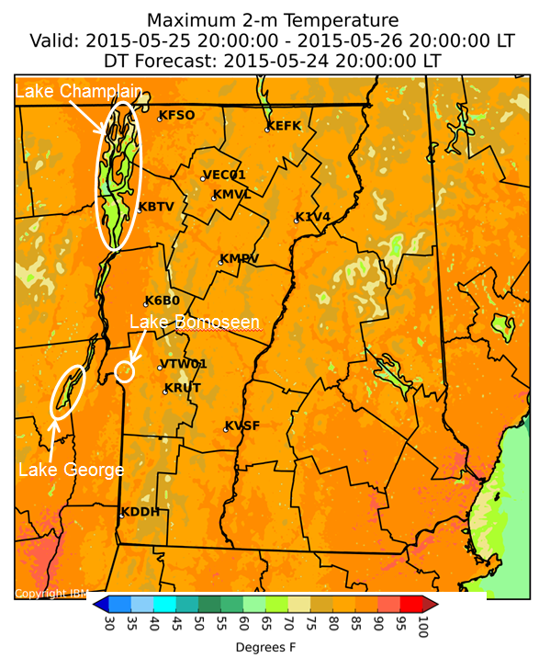
Weather (Deep Thunder)
European (ECMWF) [16km]
Forecasted Temperatures
Lake Champlain
NWS [4km]
Deep Thunder [1km]
Increased Resolution

Slide 15
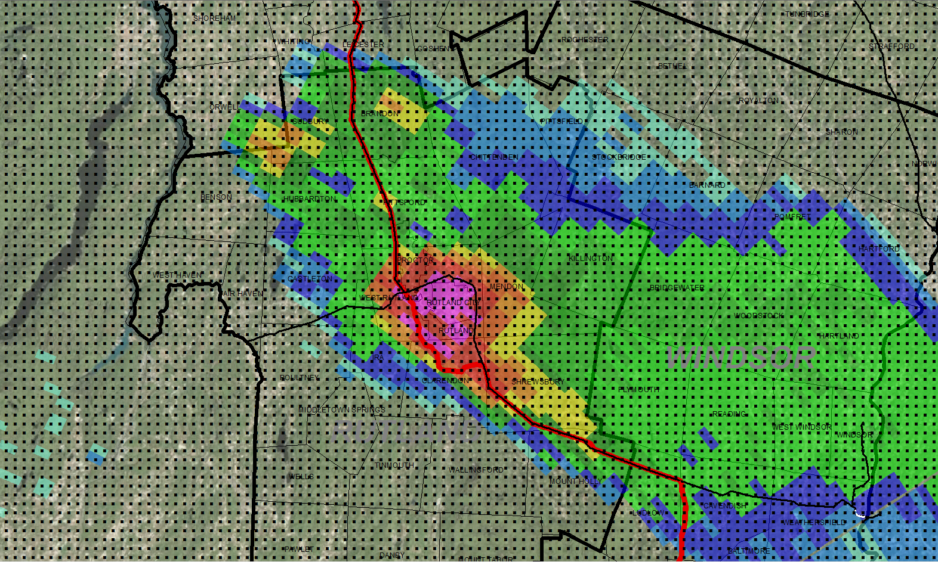
IBM Deep Thunder
Model Specifications
Observed radar on 5/27/14 – Isolated supercell over Rutland that produced golf ball-sized hail, high wind gusts, and flash flooding
Horizontal Resolution:
16 km
1 km

Slide 16
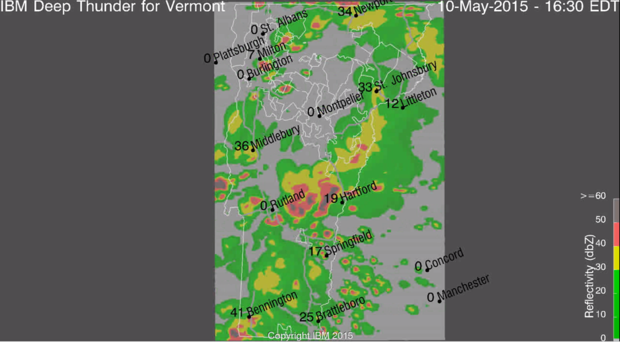
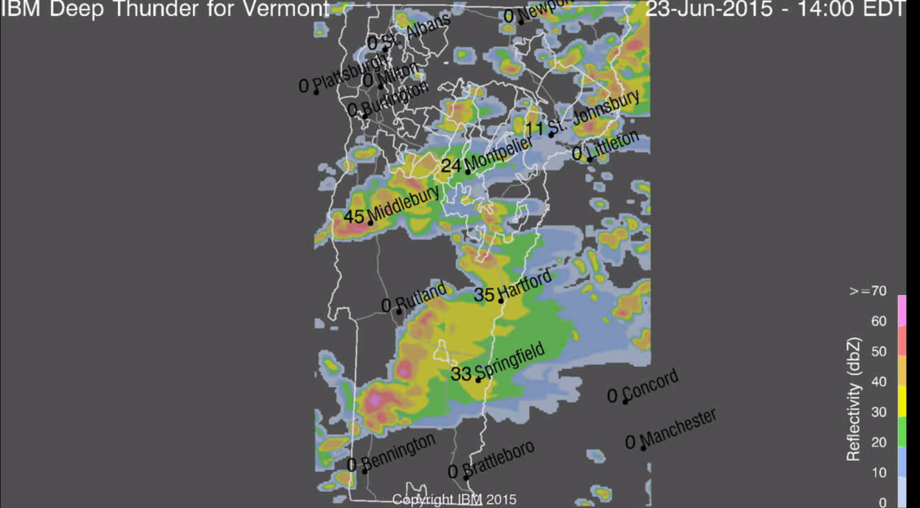
Weather (Deep Thunder)
Storm Intensity/Reflectivity
dBZ | Rate (in/hr) | Intensity
5 | < 0.01 | Hardly Noticeable
10 | < 0.01 | Light Mist
15 | 0.01 | Mist
20 | 0.02 | Very Light
25 | 0.05 | Light
30 | 0.11 | Light to Moderate
35 | 0.22 | Moderate Rain
40 | 0.45 | Moderate Rain
45 | 0.92 | Moderate to Heavy
50 | 1.90 | Heavy
55 | 3.90 | Very Heavy / Small Hail
60 | 8.00 | Extreme / Moderate Hail
65 | 15.6 | Extreme / Large Hail
Previous
New color scheme removes false alarm bias (i.e. <20 dbZ) and also increases granularity for severe weather events, particularly thunderstorms
New

Slide 17
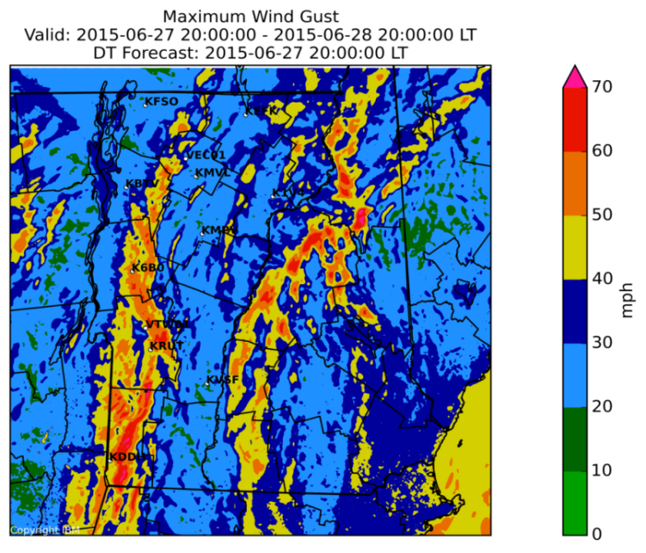
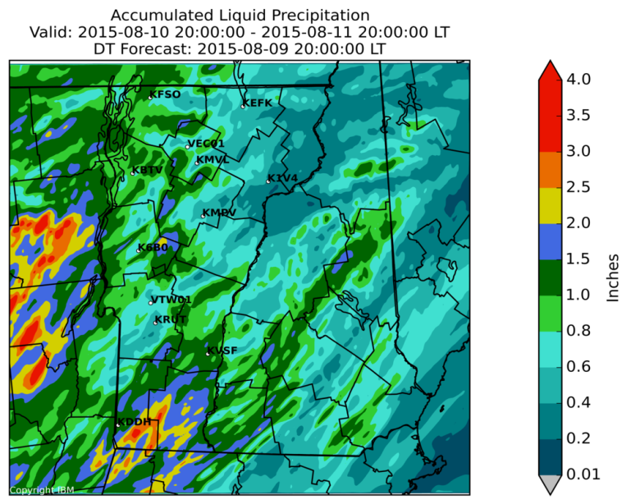
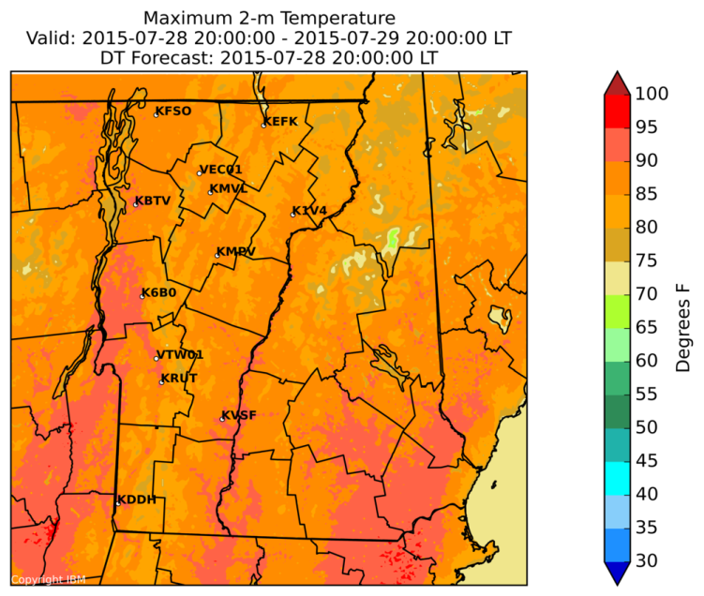
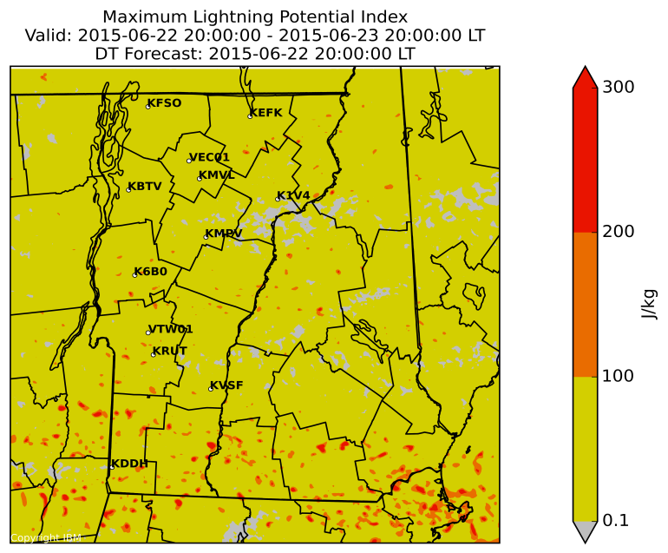
Weather (Deep Thunder)
Static Maps
Min/Max Temperatures
Max Wind Gusts
Accumulated Precipitation
Max Heat Index
Min Wind Chill
Max Lightning Potential
Max Reflectivity

Slide 18
Demand Model
Deep Thunder
Demand
Renewable
Renewable Integrated Stochastic Engine (RISE)
Developments
Migrated to new 1 km weather model
More than doubled number of distribution nodes from 120 to 255 out of 278
Achieved +/- 3-8% forecasting accuracy range at distribution substations
Held demonstration workshop with DUs to identify use cases and share model enhancements
Milestones
Decreased mean absolute percentage error (MAPE)
  Vermont state: from 2.9% to 2.4%
  GMP: from >5% to 2.4%
  BED: from >5% to 2.6%
  VEC: from >5% to 3.1%
Next steps
Improve forecasting accuracy for state and DUs using real-time data and ingestion of additional weather station data
Deploy models for remaining 23 distribution nodes

Slide 19
Renewable
Deep Thunder
Demand
Renewable
Renewable Integrated Stochastic Engine (RISE)
Developments
Migrated to new 1 km weather model
Began delivery of daily KCW power forecasts
Expanded renewable generation modeling to include 19 solar and three wind farms
Developed new user interface consistent with the look and feel of rest of portal
80% power forecasting precision at farm level; 86% prediction accuracy for solar
Milestones
Automated real-time MV90 and KCW data feeds from GMP
Next steps
Continue to improve KCW forecasting accuracy
Develop and deliver Georgia Mountain Wind, Sheffield and Searsburg daily wind power forecasts
Share portal output with wind and solar farm owners
Investigate ability to forecast turbine icing potential
Provide wind power forecasts to ISO-NE

Slide 20
Verification – Performance Metrics
Metric Description | December 2014 |  | April 2015 |  | June 2015
 | Goal | Actuals | Goal | Actuals | Goal | Actuals
Wind speed error Wind direction error | 1 – 4 m/sec 4 – 6 degrees | 1 – 4 m/sec 4 – 6 degrees | 1 – 2 m/sec 1 – 4 degrees | 1 – 2 m/sec 1 – 4 degrees | 1 m/sec 1 – 2 degrees | 1.65 m/sec .09 degrees
Wind power forecast precision (farm-level) | 75% 1 wind farm | 75% 1 wind farm | 85% 4 wind farms | 85% 2 wind farms* | 85% 3 wind farms | 80% with alarm data 1 wind farm*
Solar power forecast precision (farm-level) | 86% 1 solar farm | 86% 1 solar farm | >86% 12 solar farms | >86% 12 solar farms | 17 solar farms | 12 farms with 86% accuracy
Demand forecast accuracy, state level (MAPE) | No goals set | +/- 4.5% 41 substations | +/- 3.0% 60 substations | +/-2.9% 83 substations** | <2% for state & DU service territory <5% for distribution substations | State: 2.4% DUs: 2.7% Substations 3-8%
* Additional wind farm data in process
** In some cases, forecasts include total loads aggregated from more than one substation (typically 1-4) for a total of 255 substations

Slide 21
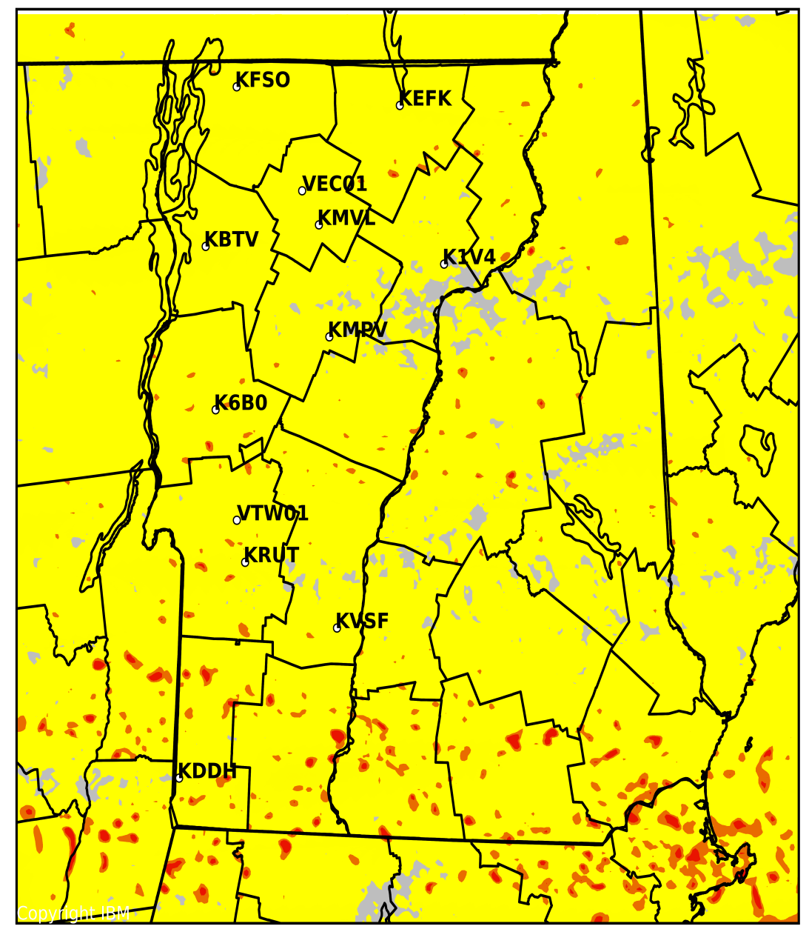
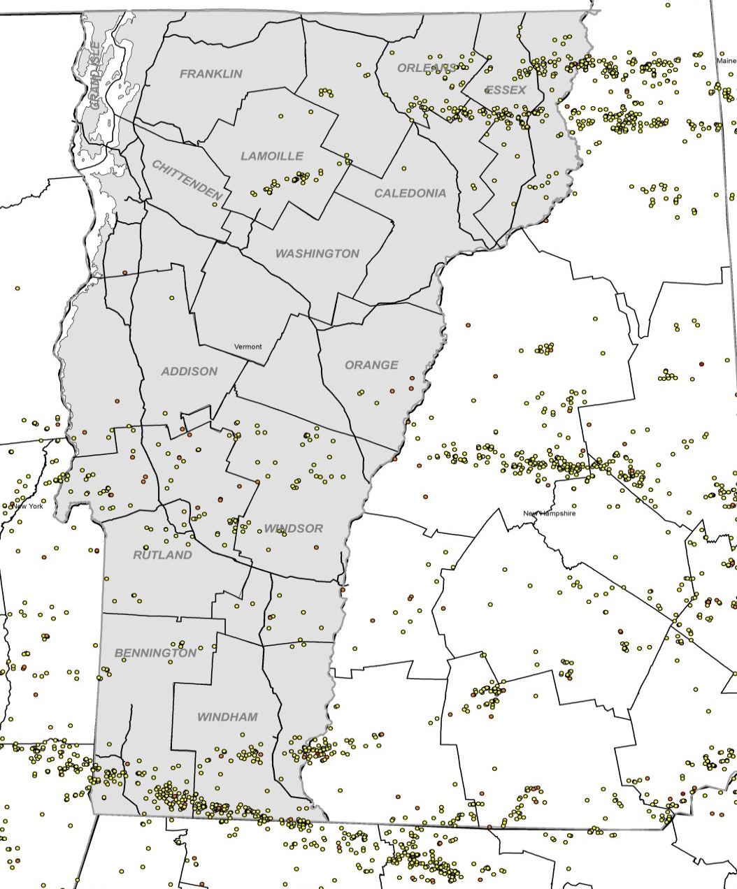

Verification – Lightning Forecasting
Event: June 23, 2015
Deep Thunder (LPI)
Observed
Low
Medium
High

Slide 22
Verification – Wind Power Forecasting
Forecast | MAE (MW) | % Error
VTWAC | 8.0 | 13%
ISO-NE | 12.4 | 20%

Slide 23
 | 3/30/2015 (Mon) | 3/31/2015 (Tue)
Cloud Cover | Overcast | Sunny
High/Low (°F) | 41/26 | 42/24
Max Radiation (w/m^2) | 241 | 965
2 weekdays with similar temperatures but large differences in cloud cover
Overcast

Slide 24
Future Work
Finalize hardware/software strategy for ongoing project
Additional training with VT-DU’s (Cycle 3 – October)

Slide 25
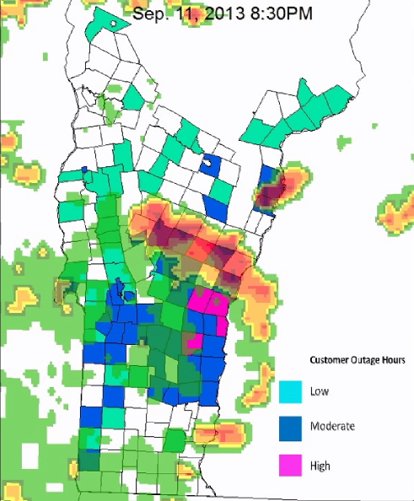
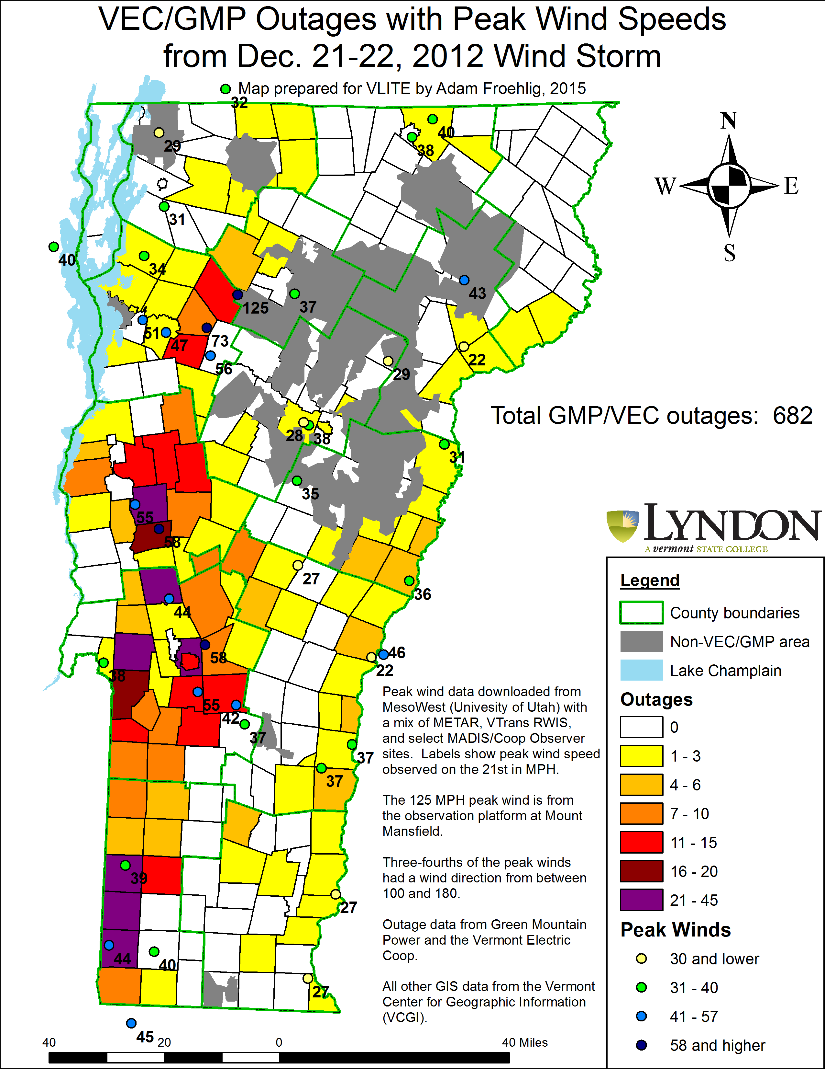
Future Applications
Weather Research & Outage Database → Impact Prediction: LSC Students/Staff
Credit: Tyler Scheibenpflug

Slide 26
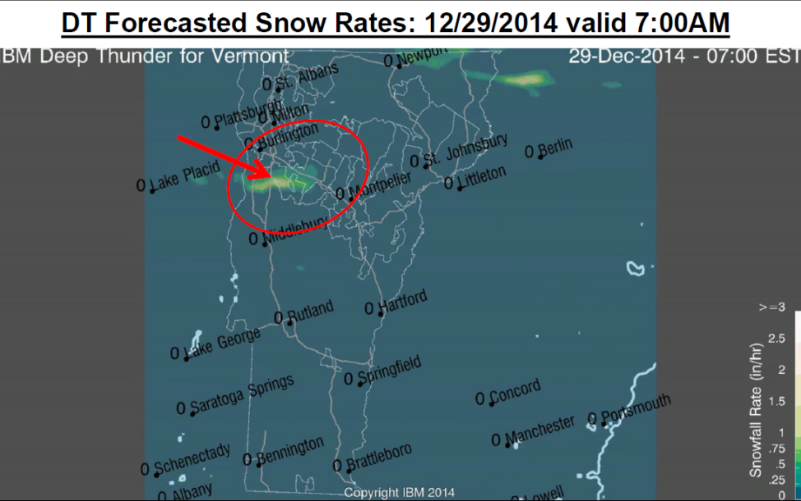
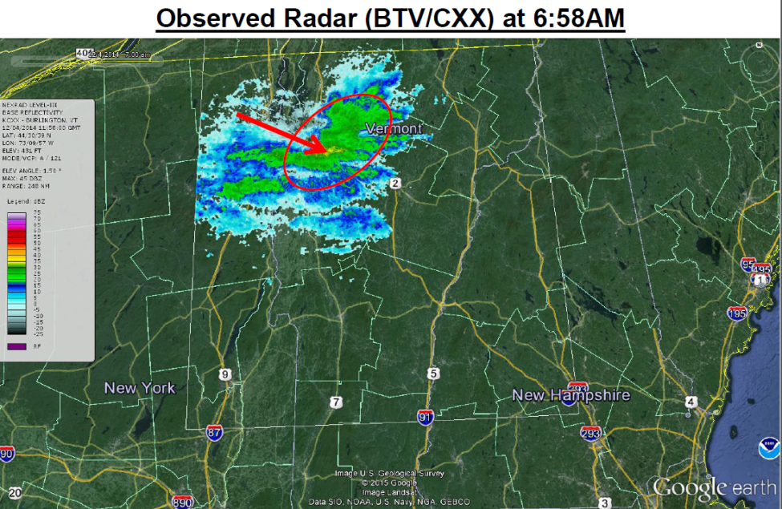
Future Applications
Road Weather Forecasting: Vermont Agency of Transportation (VTrans)

Slide 27
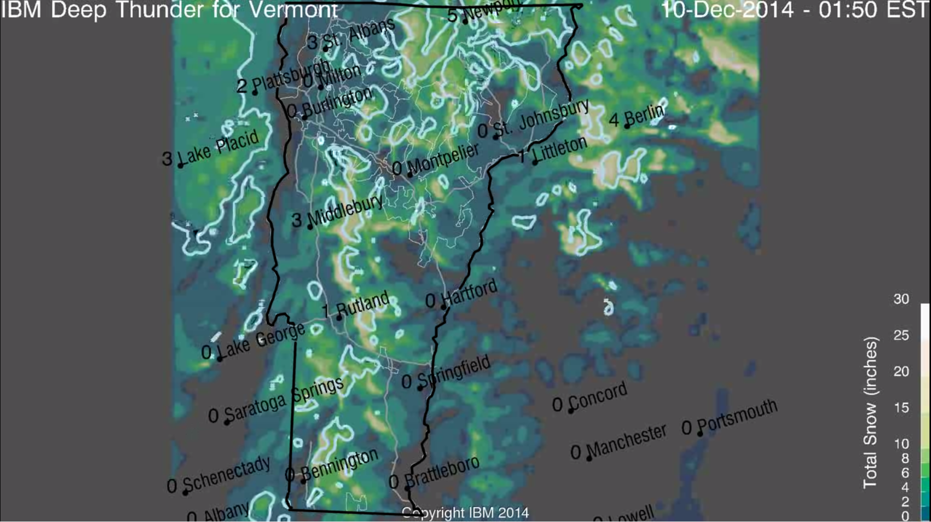
Future Applications
Recreation/Ski Forecasting: Vermont Ski Areas Association (VSAA)
Killington Forecast: 20” Observed: 19”

Slide 28
Demonstration
Vermont Weather Analytics Portal
https://vtwac.velco.com/weather/live/web2/

Slide 29
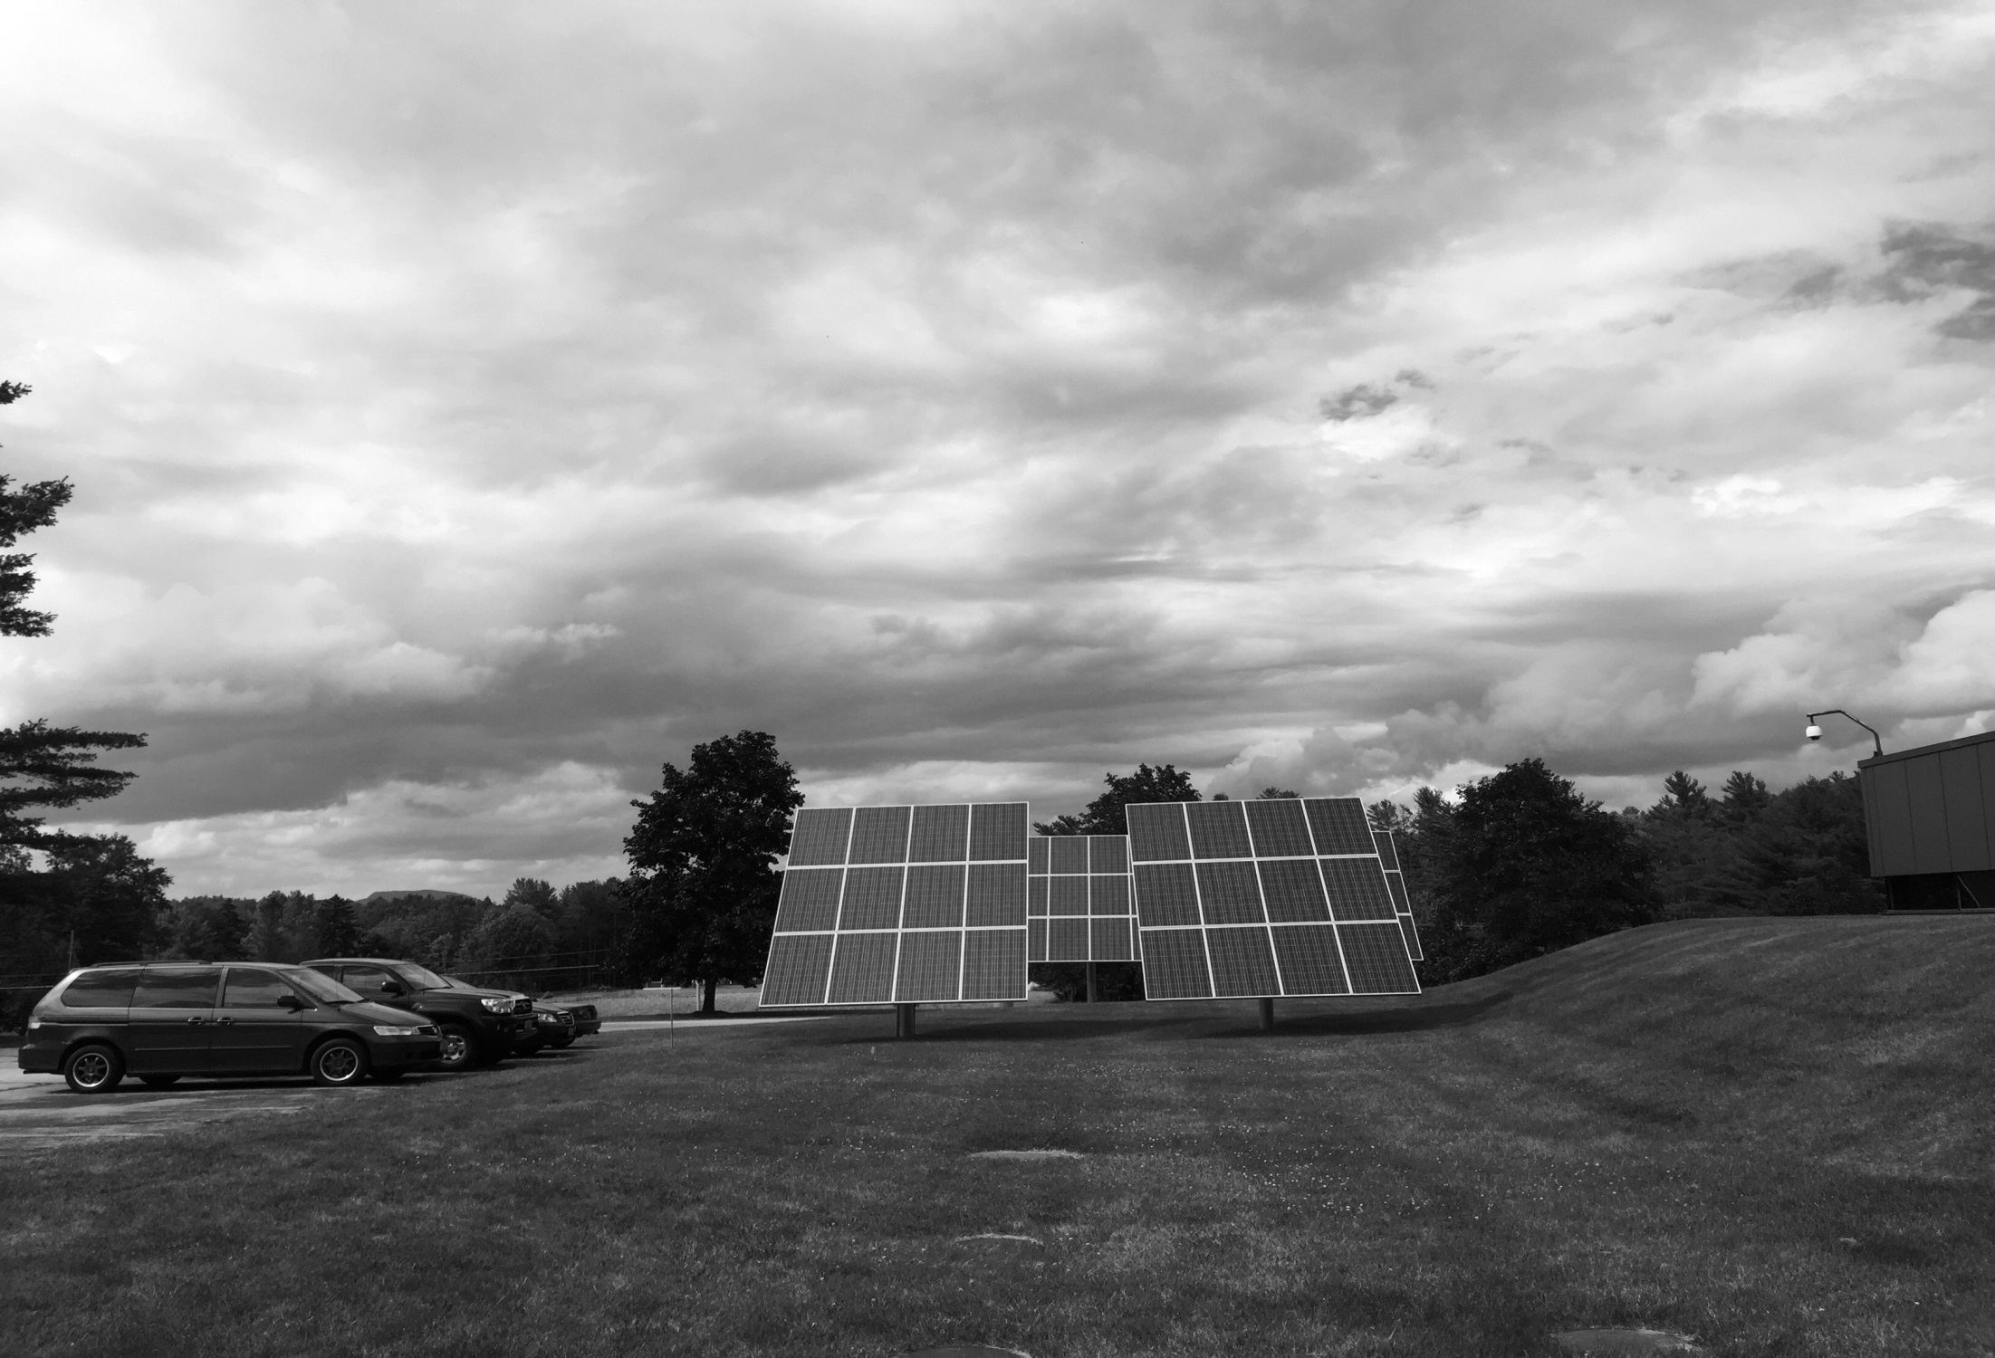
Questions?

