Slide 1
Revolutionize Electronic Design Automation (EDA) with AI: Unlocking the Power of Generative Adversarial Networks in High-Speed Receiver Modeling
Dr. Priyank Kashyap
Presented by Dr. Priyank Kashyap

Slide 2
Promote education and innovation within the IEEE community.
Objective: Platform for sharing knowledge, fostering collaboration, and inspiring creativity among educators, researchers, and students.
Wide Range of Topics: STEM education, curriculum development, online learning, and emerging technologies and other event features.
Participants can attend workshops, keynote speeches, and panel discussions led by experts in the field.
Notes:
Prestigious event aimed at promoting education and innovation within the IEEE community.
The key objectives of the event include providing a platform for sharing knowledge, fostering collaboration, and inspiring creativity among educators, researchers, and students.
The event features a wide range of topics covering areas such as STEM education, curriculum development, online learning, and emerging technologies.
Throughout the week, participants can attend workshops, keynote speeches, and panel discussions led by experts in the field. Past speakers have included renowned academics, industry leaders, and innovators who share their insights and experiences with the audience. The event aims to create a supportive environment for networking, learning, and professional development.
IEEE Education Week has had a significant impact on the educational community, offering valuable resources and opportunities for individuals looking to enhance their skills and stay updated on the latest trends in education and technology. By fostering collaboration and innovation, the event plays a key role in shaping the future of education and empowering professionals to make a positive impact in their respective fields.
----
- IEEE Education Week is a virtual event taking place from November 30 to December 4, 2020, featuring a diverse range of workshops, panels, and keynote speakers focusing on the intersection of education and technology.
address topics such as diversity and inclusion in engineering education, computational thinking, and the future of e-learning.
- Workshops cover a wide array of topics including cybersecurity education, virtual reality in education, artificial intelligence in education, and STEM education research.
- The event also includes networking opportunities for educators, researchers, and industry professionals to connect, collaborate, and share best practices in leveraging technology to enhance learning outcomes.
- IEEE Education Week highlights the importance of innovative teaching strategies, emerging technologies, and global initiatives in shaping the future of education, making it a must-attend event for those passionate about the advancement of education through technology.

Slide 3
Renowned academics, industry leaders, and innovators who share their insights and experiences with the audience.
Create a supportive environment for networking, learning, and professional development.
Offers valuable resources and opportunities for individuals to stay updated on the latest trends in education and technology.
Through these events we can shape the future of education and empowering professionals to make a positive impact in their respective fields.
Notes:
Prestigious event aimed at promoting education and innovation within the IEEE community.
The key objectives of the event include providing a platform for sharing knowledge, fostering collaboration, and inspiring creativity among educators, researchers, and students.
The event features a wide range of topics covering areas such as STEM education, curriculum development, online learning, and emerging technologies.
Throughout the week, participants can attend workshops, keynote speeches, and panel discussions led by experts in the field. Past speakers have included renowned academics, industry leaders, and innovators who share their insights and experiences with the audience. The event aims to create a supportive environment for networking, learning, and professional development.
IEEE Education Week has had a significant impact on the educational community, offering valuable resources and opportunities for individuals looking to enhance their skills and stay updated on the latest trends in education and technology. By fostering collaboration and innovation, the event plays a key role in shaping the future of education and empowering professionals to make a positive impact in their respective fields.
----
- IEEE Education Week is a virtual event taking place from November 30 to December 4, 2020, featuring a diverse range of workshops, panels, and keynote speakers focusing on the intersection of education and technology.
address topics such as diversity and inclusion in engineering education, computational thinking, and the future of e-learning.
- Workshops cover a wide array of topics including cybersecurity education, virtual reality in education, artificial intelligence in education, and STEM education research.
- The event also includes networking opportunities for educators, researchers, and industry professionals to connect, collaborate, and share best practices in leveraging technology to enhance learning outcomes.
- IEEE Education Week highlights the importance of innovative teaching strategies, emerging technologies, and global initiatives in shaping the future of education, making it a must-attend event for those passionate about the advancement of education through technology.

Slide 4
ADMIN
You can enter your question in the chat message box
Please mute both your audio and video for bandwidth purposes
Notes:
Prestigious event aimed at promoting education and innovation within the IEEE community.
The key objectives of the event include providing a platform for sharing knowledge, fostering collaboration, and inspiring creativity among educators, researchers, and students.
The event features a wide range of topics covering areas such as STEM education, curriculum development, online learning, and emerging technologies.
Throughout the week, participants can attend workshops, keynote speeches, and panel discussions led by experts in the field. Past speakers have included renowned academics, industry leaders, and innovators who share their insights and experiences with the audience. The event aims to create a supportive environment for networking, learning, and professional development.
IEEE Education Week has had a significant impact on the educational community, offering valuable resources and opportunities for individuals looking to enhance their skills and stay updated on the latest trends in education and technology. By fostering collaboration and innovation, the event plays a key role in shaping the future of education and empowering professionals to make a positive impact in their respective fields.
----
- IEEE Education Week is a virtual event taking place from November 30 to December 4, 2020, featuring a diverse range of workshops, panels, and keynote speakers focusing on the intersection of education and technology.
address topics such as diversity and inclusion in engineering education, computational thinking, and the future of e-learning.
- Workshops cover a wide array of topics including cybersecurity education, virtual reality in education, artificial intelligence in education, and STEM education research.
- The event also includes networking opportunities for educators, researchers, and industry professionals to connect, collaborate, and share best practices in leveraging technology to enhance learning outcomes.
- IEEE Education Week highlights the importance of innovative teaching strategies, emerging technologies, and global initiatives in shaping the future of education, making it a must-attend event for those passionate about the advancement of education through technology.

Slide 5
A BIG THANK YOU TO ALL THE CO-HOSTS LISTED HERE!!!

Slide 6
A BIG THANK YOU TO ALL THE CO-HOSTS LISTED HERE!!!
Dr. Priyank Kashyap

Slide 7
Revolutionize Electronic Design Automation (EDA) with AI:
Unlocking the Power of Generative Adversarial Networks in High-Speed Receiver Modeling
Presented by Dr. Priyank Kashyap
Hardware Engineering Specialist at Hewlett-Packard Enterprise
Expertise in Machine Learning and Signal Integrity
Keen Interest in Electronic Design Automation (EDA), Hardware Security, and Quantum Computing
Best Paper Award at DesignCon 2023, advancing technology in his field

Slide 10
CEUs/PDH and Google Folders
Dr. John Santiago
John Santiago, Col (Retired, Ph.D.), USAF
Past Section Chair & Current Webmaster
Educational Activities Coordinator for Region 5
Notes:
AI Notes;
Prompt for George Washington as Captain America: George Washington as captain america superhero character flying over dc
Prompt for Elon Musk as Ironman: Elon Musk as Ironman
Prompt for Space Tourism overlooking earth: space tourism with passengers viewing earth
Prompt for this Hybrid Meeting: a cartoon of a meeting room with 10 laptops facing a cartoon of a man and woman talking to each other and a cartoon of a man on a computer, new objectivity, a cartoon, Allen Tupper True, cartoon (based on a cartoon)
Prompt for Zorro: close up of zorro, upload my picture and replace zorro iage

Slide 11
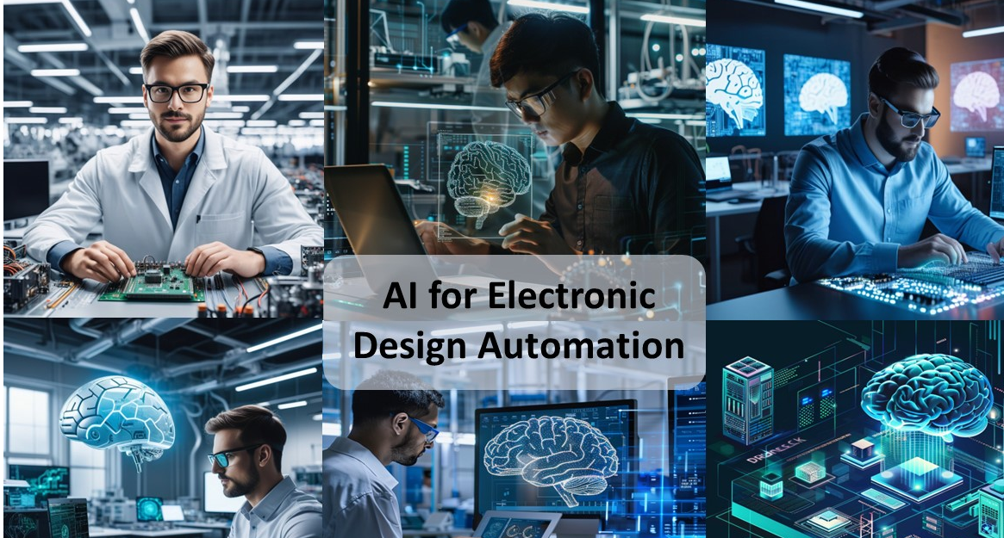
Revolutionize Electronic Design Automation (EDA) with AI:
Unlocking the Power of Generative Adversarial Networks in High-Speed Receiver Modeling
Presented by Dr. Priyank Kashyap
Notes:
Prompt
Provide 10 questions on generative adversarial networks used on electronic design automation, include pros and cons of this approach, identify alternative approaches
Advanced Prompt
Develop a list of 10 insightful questions exploring the application of generative adversarial networks (GANs) in electronic design automation. Incorporate the advantages and disadvantages of using GANs in this context, and discuss potential alternative approaches that could be considered for achieving similar outcomes. Ensure the questions are thought-provoking and encourage in-depth exploration of the topic to facilitate a comprehensive understanding of the subject matter.
Questions
1. How can GANs be leveraged in the context of electronic design automation to efficiently generate new and innovative circuit designs?
2. What are the primary benefits of using GANs in electronic design automation, such as improved productivity, reduced design time, and increased design complexity? (compare with video production)
3. What are the potential drawbacks or limitations of incorporating GANs into the electronic design process, such as challenges with model training, data availability, and interpretability of results? (how much training, the availability of data and its sources, genetic algorithms in terms of layout
4. How do GANs compare to traditional machine learning techniques in electronic design automation, and what specific advantages do they offer in terms of generating realistic and diverse design examples?
5. How can GANs be adapted and optimized to address the specific requirements and constraints of electronic design automation, such as design rule compliance, power efficiency, and performance optimization?
6. What are some real-world applications of GANs in electronic design automation, and how have they contributed to advancements in the field of hardware design and development?
7. Are there any ethical considerations or concerns associated with using GANs in electronic design automation, such as potential biases in generated designs or implications for intellectual property rights?
8. What alternative approaches or strategies could be considered for achieving similar outcomes in electronic design automation, such as using reinforcement learning, evolutionary algorithms, or traditional optimization techniques?
9. How can GANs be integrated into existing design tools and workflows to enhance the overall design process and facilitate collaboration between designers, engineers, and researchers?
10. What are the future prospects and potential challenges of incorporating GANs into electronic design automation, and how can researchers and practitioners address these challenges to further advance the use of generative adversarial networks in hardware design?

